Slide 1
dna & genealogy NELSON SMITH 3/23

Slide 2
DNA IS
NEW SCIENCE

Slide 3
DNA IS
VERY, VERY, VERY
COMPLICATED!

Slide 4
DNA CHALLANGES OUR PRESENT UNDERSTANDING

Slide 5
DNA IS
GENERALY MISUNDERSTOOD!

Slide 6
OBJECTIVES
BACKGROUND
DNA FUNDAMENTALS
DNA TESTING
DNA TESTING RESULTS

Slide 7
PART 1
BACKGROUND
&
DNA FUNDAMENTALS

Slide 8
IDENTIFICATION
VERIFICATION

Slide 9
IDENTIFICATION
ESTABLISHES A
SPECIFIC THING
OR PERSON

Slide 10
VERIFICATION CONFIRMS A GROUP CONTAINS A THING OR PERSON

Slide 11
A BRIEF HISTORY
OF
IDENTIFICATION

Slide 12
GENESIS 3:20
ADAM NAMES WOMAN
EVE

Slide 13
WEALTHY EGYPTIAN USE WAX & A DIE

Slide 14
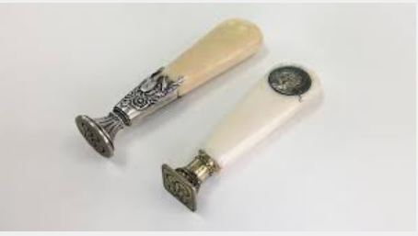

Slide 15
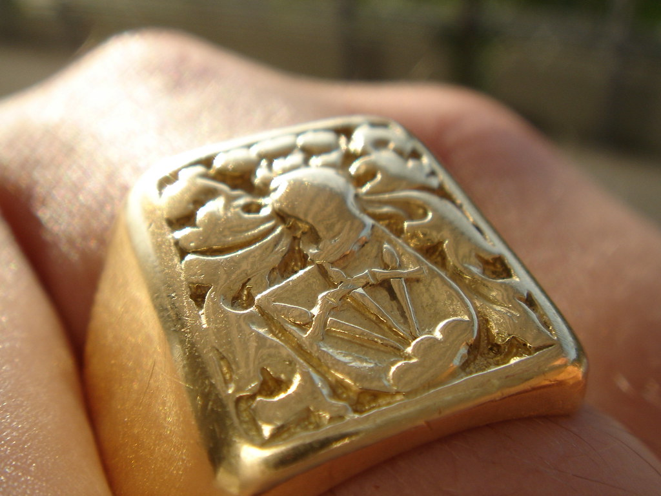
DNA - Genealogy

Slide 16
A QUALIFIER IS ADDED TO A NAME

Slide 17
WILLIAM LIVING IN NORMANDY
BECOMES
WILLIAM de NORMANDY
JOHN’S SON LUKE
BECOMES
LUKE JOHNSON

Slide 18
IN THE 1700’S
BEGAN USING
PHYSICAL FEATURES

Slide 20
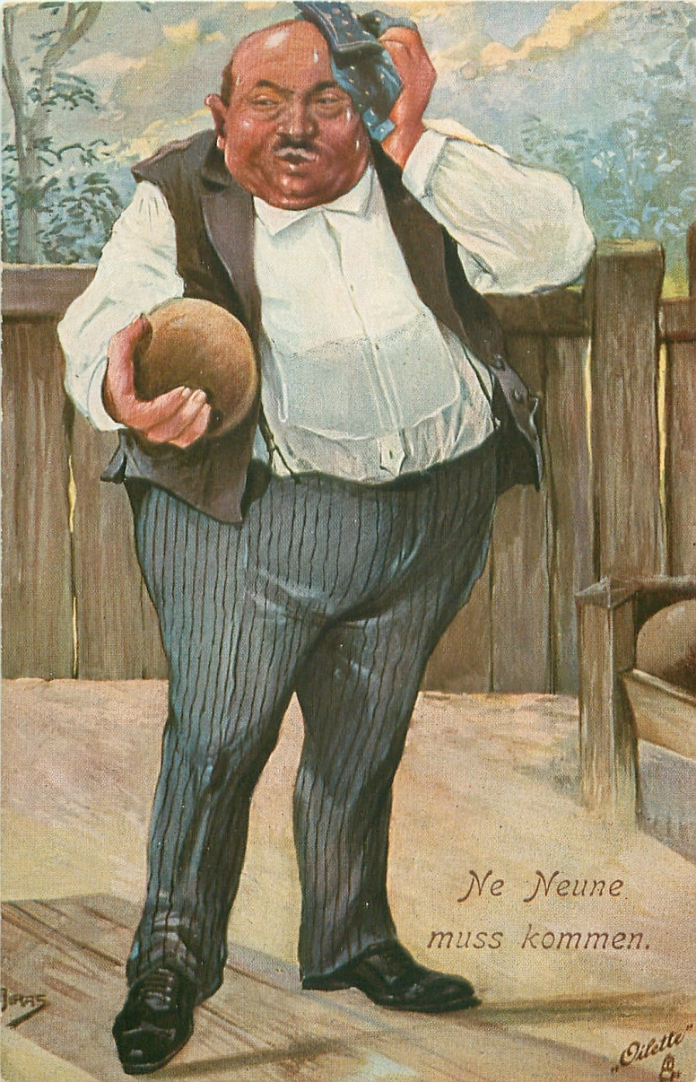

Slide 21
FEATURES MEASUREMENT

Slide 22
FINGER
RIDGE & SWIRLS

Slide 23
EDWARD HENRY CLASSIFICATION SYSTEM
1900’S

Slide 24
1 IN 6,000,000,000

Slide 25
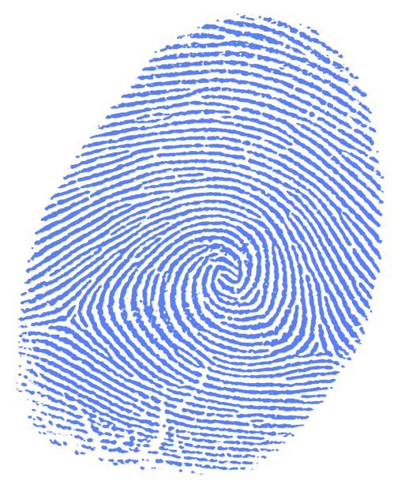
FINGERPRINTS ARE THE GOLD STANDARD OF IDENTIFICATION

Slide 26
BIG
PROBLEM WITH TOOLS FOR
IDENTIFICATION

Slide 27
MOST TOOLS FOR IDENTIFICATION DISAPPEAR OVER TIME!

Slide 28
DNA - Genealogy
1850 SCIENTISTS BEGAN TO FEEL TRUE IDENTITY IS CELLULAR

Slide 29
DNA - Genealogy
1870 FREDRICK MIESCHER RESEARCHING AND CATALOGING PROTEINS

Slide 31
DNA - Genealogy
FREDRICK MIESCHER DISCOVERS A SUBSTANCE HE CALLS NUCLEIN

Slide 32
DNA - Genealogy
NUCLEIC ACID

Slide 33
DNA - Genealogy
NUCLEIC ACIDS
ARE SMALL BIOMOLECULES ESSENTIAL FOR ALL KNOWN FORMS OF LIFE

Slide 34
DNA - Genealogy
NUCLEIC ACID IS THE OVERALL NAME FOR DNA AND RNA

Slide 35
DNA - GEnealogy
DEOXYRIBONUCLEIC ACID
RIBONUCLEIC ACID

Slide 36
DNA - Genealogy
DNA IS FOUND IN A CELL’S NUCLEUS AND MITROCHONDIA
RNA IS FOUND IN AND AROUND A CELL’S NUCLEUS

Slide 37
DNA - Genealogy
DNA CONTAINS THE INSTRUCTIONS FOR THE CONTROL, FUNCTIONING, GROWTH AND REPRODUCTION OF ALL LIVING ORGANISMS
RNA CARRIES THE DNA’S INSTRUCTIONS TO PROTEINS

Slide 38
DNA - Genealogy
ALL CELLS IN A LIVING ORGANISM HAVE DNA EXCEPT IN BLOOD

Slide 39
DNA - Genealogy
TWO MAJOR COMPONENTS
WHITE CORPUSELS
RED CORPUSELS

Slide 40
DNA - Genealogy
WHITE CORPUSELS - HAVE DNA
RED CORPUSELS – DO NOT

Slide 41
DEGRADE
MUTATE

Slide 42
DEGRADE MEANS A SLOW WASTING AWAY

Slide 43
MUTATE MEANS A SIGNIFICANT BASIC CHANGE

Slide 44
SOME DNA CAN MUTATE!
DNA DOES NOT DEGRADE!

Slide 45
DNA - Genealogy
IN 1953 WATSON AND CRICK WORKING AT CAMBRIDGE UNIVERSITY
FIRST MODELED DNA

Slide 46
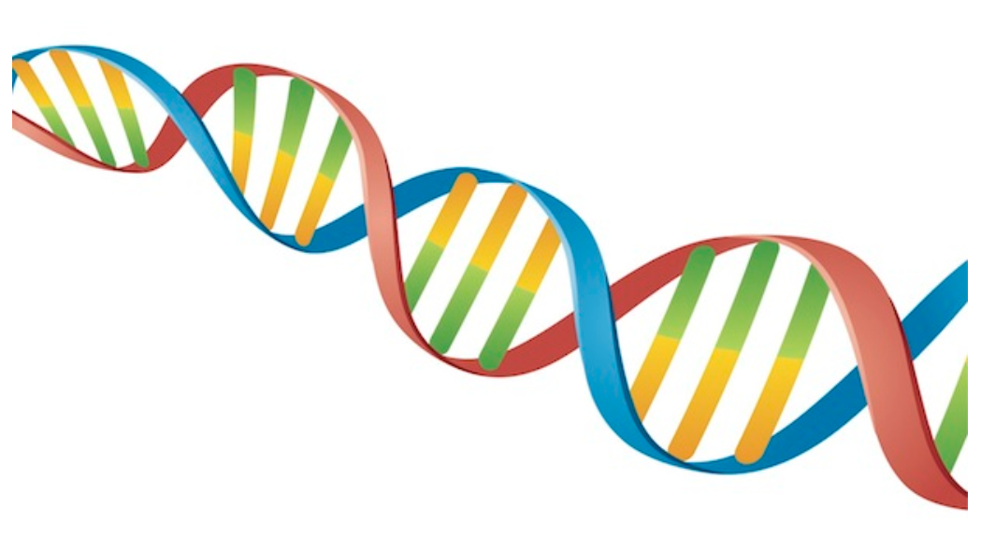
Genealogy - dna

Slide 47
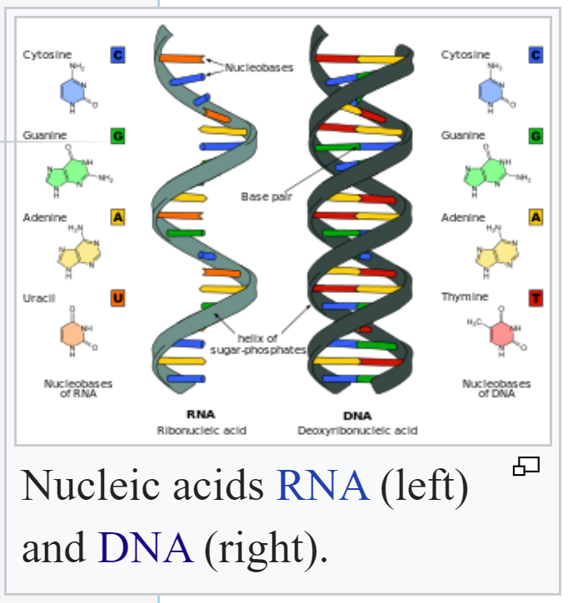
Genealogy - dna

Slide 48
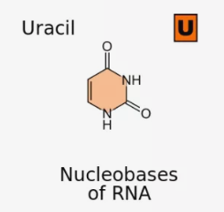
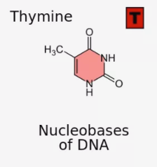
Genealogy - dna

Slide 49
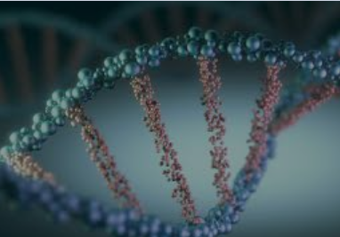
Genealogy - dna

Slide 50
DNA - Genealogy
DNA
IS A GENERIC TERM FOR SEVERAL TYPES OF
DEOXYRIBONUCLEIC ACID

Slide 51
DNA - Genealogy
THREE TYPES OF DNA
FOR GENEALOGY TESTING
NUCLEAR DNA MITOCHRONDRICAL DNA AUTOSOMAL DNA

Slide 52
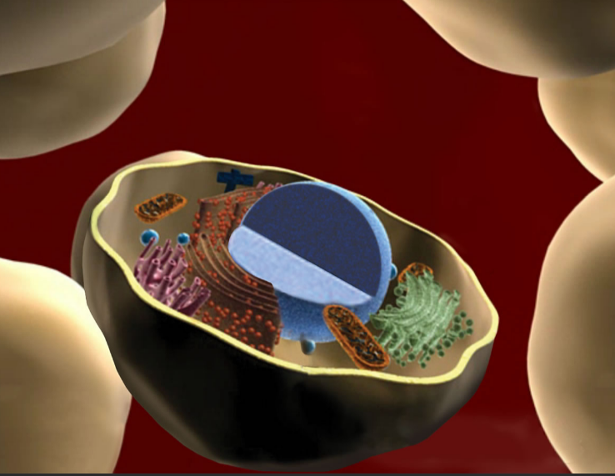
Genealogy - dna

Slide 53
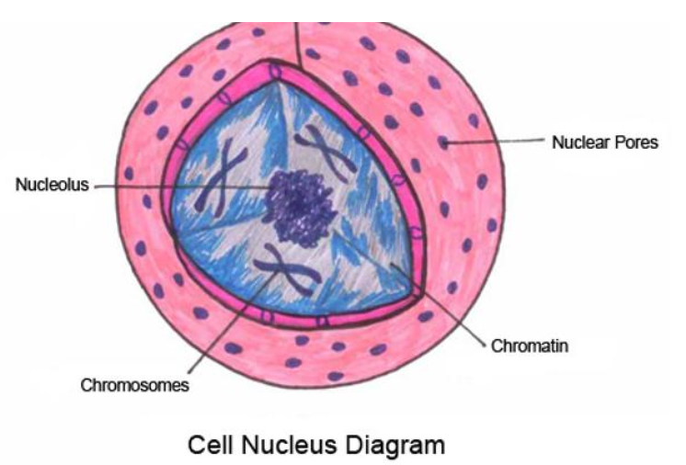
Genealogy - dna

Slide 54
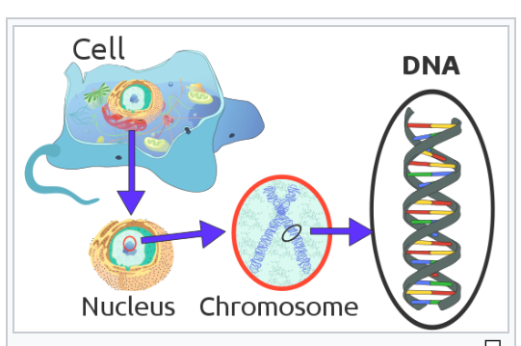
Genealogy - dna

Slide 55
DNA - Genealogy
EACH CHROMOSONE IS ONE DNA MOLECULE

Slide 56
DNA - Genealogy
SPREAD OUT EACH CHROMOSOME WOULD BE APPROXIMATELY THREE FEET IN LENGTH

Slide 57
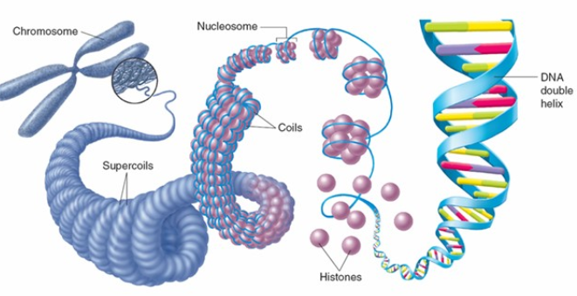

Slide 58
DNA - Genealogy
DIFFERENT CHROMSOMES
FRUIT FLY 8

Slide 59
DNA - Genealogy
DIFFERENT CHROMSOMES
FRUIT FLY 8
CAT 38

Slide 60
DNA - Genealogy
DIFFERENT CHROMSOMES
FRUIT FLY 8
CAT 38
HUMAN 46

Slide 61
DNA - Genealogy
DIFFERENT CHROMSOMES
FRUIT FLY 8
CAT 38
HUMAN 46
DOG 78

Slide 62
DNA - Genealogy
DIFFERENT CHROMSOMES
FRUIT FLY 8
CAT 38
HUMAN 46
DOG 78
BUTTERFLY 180

Slide 63
DNA - Genealogy
DIFFERENT CHROMSOMES
FRUIT FLY 8
CAT 38
HUMAN 46
DOG 78
BUTTERFLY 180
AMEOBA 500

Slide 64
DNA - Genealogy
THE 46 CHROMOSOMES IN HUMANS CONSIST OF 23 PAIRS
22 PAIRS ARE IDENTICAL IN MALES &
FEMALES
ONE PAIR - THE SEX CHROMOSOME IS DIFFERENT IN MALES & FEMALES

Slide 65
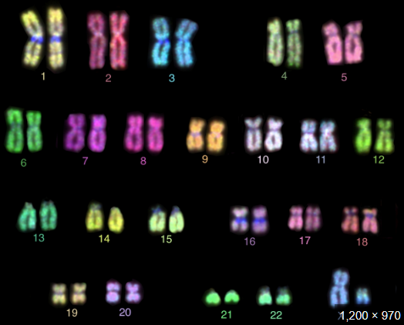

Slide 66
DNA - Genealogy
SEX
CHROMOSOMES

Slide 67
DNA - Genealogy
ALL MALES HAVE AN
X AND A Y SEX CHROMOSOME
ALL FEMALES HAVE TWO X
SEX CHROMOSOMES

Slide 68
DNA - Genealogy
A FEMALE’S EGG HAS ONLY
X CHROMOSOMES
A MALE’S SPERM CONTAINS X AND Y CHROMOSOMES

Slide 69
DNA - Genealogy
WHEN A Y CHROMOSOME ENTERS THE FEMALE’S EGG
THE OFF-SPRING IS MALE
WHEN AN X CHROMOSOME ENTERS THE FEMALE’S EGG
THE OFF-SPRING IS FEMALE

Slide 70
DNA - Genealogy
SEX CHROMOSOMES DO NOT MUTATE!

Slide 71
DNA - Genealogy
SEX CHROMOSOMES ARE PASSED
RELATIVELY UNCHANGED FROM THEIR PARENT

Slide 72
DNA - Genealogy
SEX CHROMOSOMES
ARE RELATIVELY UNCHANGED FOR THOUSANDS OF YEARS

Slide 73
DNA - Genealogy
POSSIBLE TO VERIFY THE MALE ANCESTRY FOR
HUNDREDS OF
GENERATIONS BY EXAMINING THE DNA OF THE Y CHROMOSOME

Slide 74
DNA - Genealogy
FOR THE FEMALE
NEED TO LOOK ELSEWHERE

Slide 75
DNA - Genealogy
MITOCHONDRIAL DNA

Slide 76
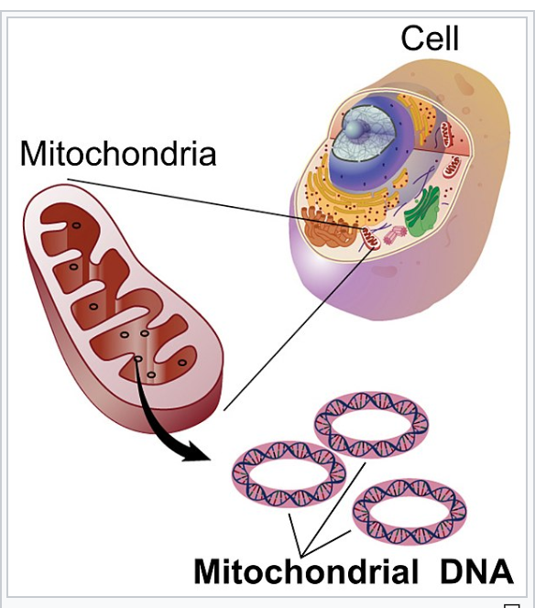
Genealogy - dna

Slide 77
DNA - Genealogy
POSSIBLE TO VERIFY THE FEMALE ANCESTRY BY
EXAMINING THE MtDNA

Slide 78
DNA - Genealogy
AUTOSOMAL DNA

Slide 79
DNA - Genealogy
DNA
IN THE OTHER 22 PAIRS OF CHROMOSOMES

Slide 81
DNA - Genealogy
IN THE OTHER 22 PAIRS OF CHROMSOMES
DNA CAN MUTATE!

Slide 82
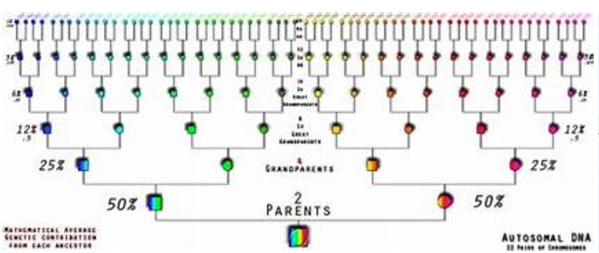
Genealogy - dna

Slide 83
DNA - Genealogy
AUTOSOMAL DNA IS UNRELIABLE TO TRACE ANCESTRY BEYOND THE FIFTH GENERATION

Slide 84
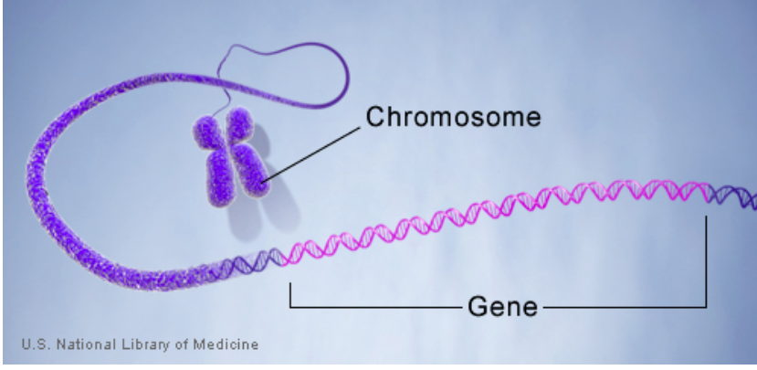
Genealogy - dna

Slide 85
DNA - Genealogy
A GENE IS A UNIT OF
HEREDITY INFORMATION THAT OCCUPIES A FIXED POSITION ON DNA

Slide 86
DNA - Genealogy
IT IS ESTIMATED THAT THE
HUMAN BODY CONTAINS UP TO 25,000 GENES

Slide 87
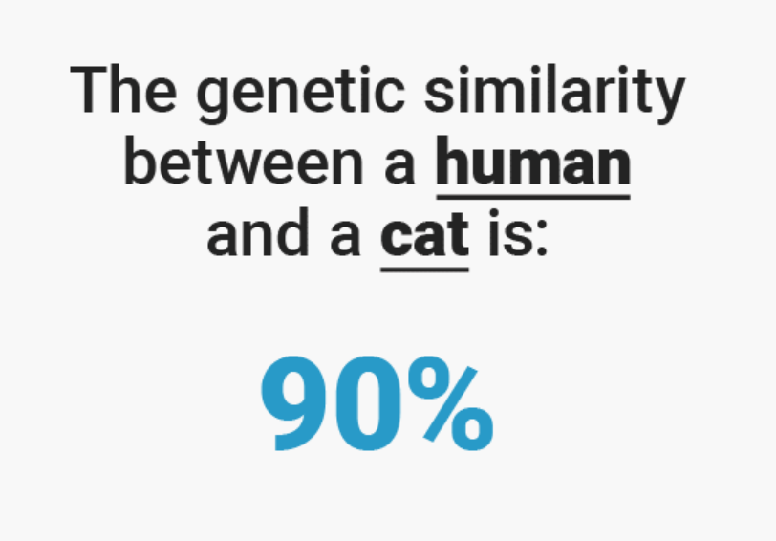
DNA - Genealogy

Slide 88
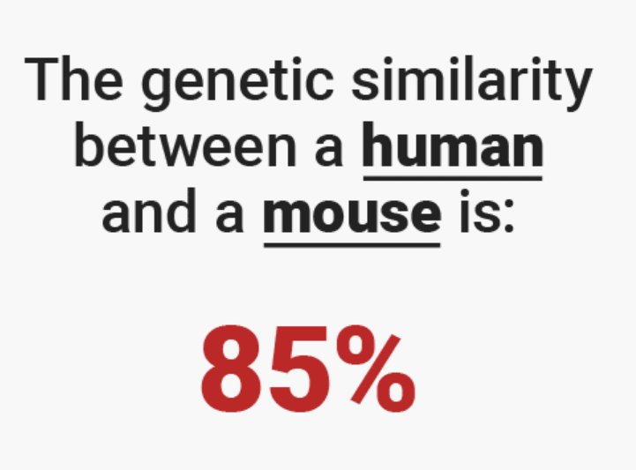
DNA - Genealogy

Slide 89
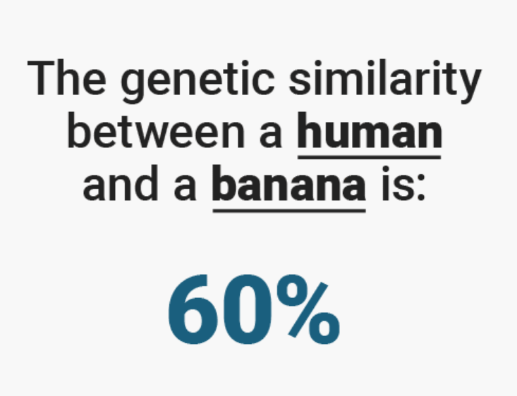
DNA - Genealogy

Slide 90
DNA - Genealogy
IN 1990 THE WORLD-WIDE
HUMAN GENOME PROJECT
WAS LAUNCHED

Slide 91
DNA - Genealogy
OBJECTIVES WERE TO
IDENTIFY & MAP ALL OF THE HUMAN GENES
DETERMINE THE BASE PAIRS THAT
MAKE-UP HUMAN DNA

Slide 92
DNA - Genealogy
HUMAN GENOME PROJECT
COMPLETED APRIL 3, 2003

Slide 94
DNA - Genealogy
MUCH OF WHAT WE KNOW ABOUT DNA IS LESS THAN 30 YEARS OLD!

Slide 95
DNA CAN MUTATE!
DNA DOES NOT DEGRADE!

Slide 96
DNA IS ABOUT
VERIFICATION
NOT IDENTIFICATION

Slide 97
DNA - Genealogy
QUESTIONS???

Slide 98
DNA - Genealogy
APRIL 11TH
PART 2
DNA TESTING
DNA TEST RESULTS

