Slide 1
DNA-GENEALOGY
NELSON SMITH 4/23

Slide 2
PART 2
DNA TESTING
DNA TEST RESULTS

Slide 3
REVIEW OF PART 1

Slide 4
ANCESTRY - DNA
IDENTIFICATION
VERIFICATION

Slide 5
ANCESTRY - DNA
IDENTIFICATION
ESTABLISHES A SPECIFIC PERSON OR THING

Slide 6
ANCESTRY - DNA
TIME DEGRADES IDENTIFICATION!

Slide 7
ANCESTRY - DNA
VERIFICATION
CONFIRMS THE PRESENCE

Slide 8
DNA DOESN’T DEGRADE WITH TIME!

Slide 9


Slide 10
DNA ANALYSIS CAN’T
IDENTIFY A PERSON
IDENTIFY SURNAME ORIGIN
IDENTIFY YOUR ETHNIC TRIBE
IDENTIFY A DISEASE

Slide 11
DNA ANALYSIS CAN
VERIFY AN IDENITY
VERIFY AN ADOPTION
VERIFY GENEALOGY RECORDS
VERIFY A COMMON ANCESTOR
VERIFY A COMMON GENE

Slide 12
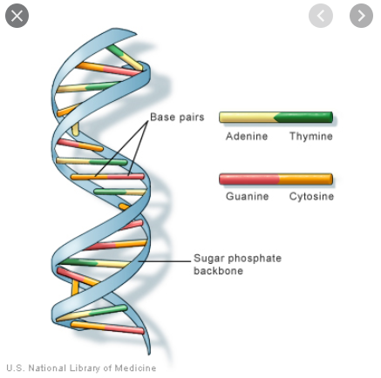

Slide 13
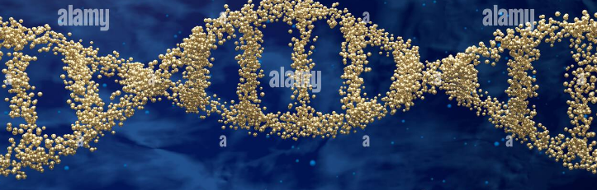

Slide 14
DNA ANALYSIS

Slide 15
ANCESTRY - DNA
DNA ANALYSIS USES
TWO TOOLS
MAPPING
SEQUENCING

Slide 16
ANCESTRY - DNA
MAPPING
ESTABLISHES THE LOCATION OF
& DISTANCE BETWEEN GENES

Slide 17
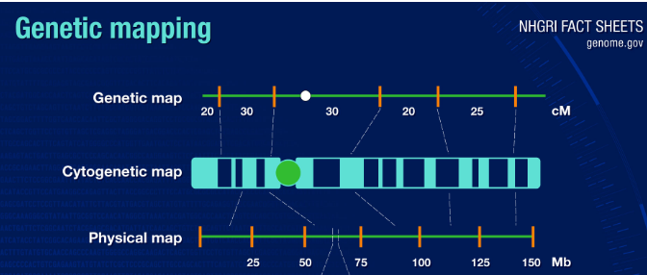

Slide 18
ANCESTRY - DNA
SEQUENCING
DETERMINES THE QUANTITY
& BASE TYPE AT A GIVEN LOCATION

Slide 20
ANCESTRY - DNA
APPROX 3 BILLION
BASES IN EACH CHROSOME

Slide 21
ANCESTRY - DNA
BASES COMBINE BASED ON RULES

Slide 22
ANCESTRY - DNA
DNA TESTING

Slide 23

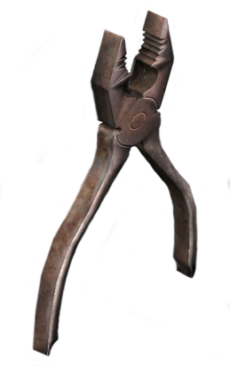
ANCESTRY - DNA
DNA TESTING IS
A TOOL
NOT A END!

Slide 24
ANCESTRY - DNA
DIFFERENT TASKS REQUIRE DIFFERENT TOOLS!

Slide 25
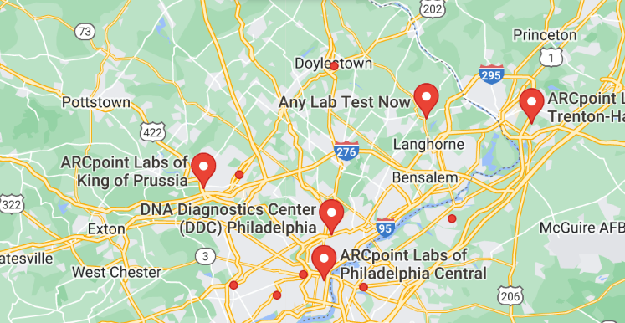

Slide 26
ANCESTRY - DNA
GENEALOGY RESULTS
REQUIRE GENEALOGY
TESTING COMPANIES

Slide 27
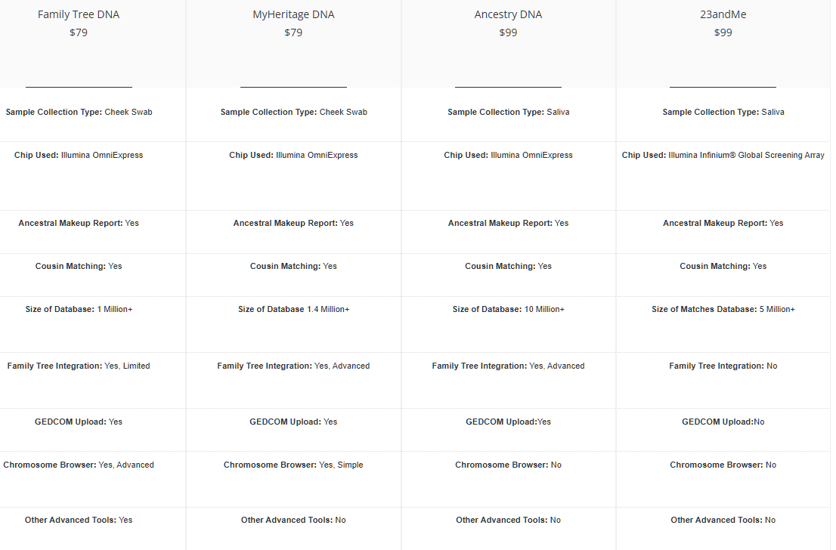

Slide 28

ANCESTRY - DNA
PRICES

Slide 29
ANCESTRY - DNA
FIRST
DETERMINE YOUR OBJECTIVES

Slide 30
ANCESTRY - DNA
CONSIDERATIONS
1. WHAT AM I TRYING TO FIND?
2. WHAT WILL I DO WITH THE RESULTS?
3. HOW MUCH MONEY AM I WILLING TO SPEND?
4. HOW MUCH TIME DO I HAVE?

Slide 31
PURCHASE ONLINE

Slide 32
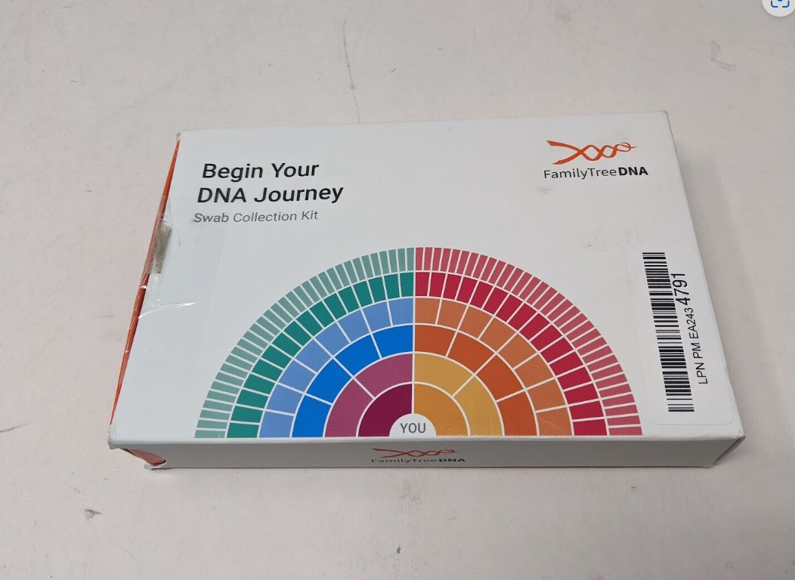
ANCESTRY - DNA

Slide 33
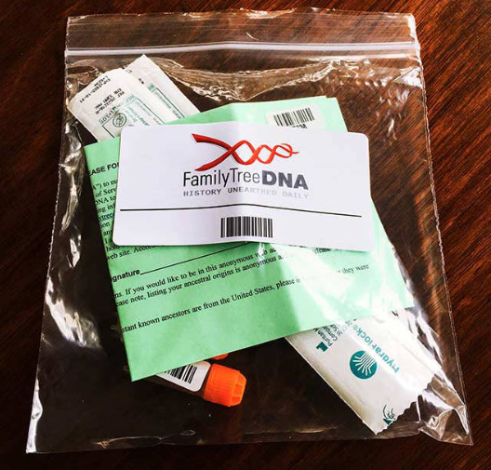
ANCESTRY - DNA

Slide 34


Slide 35
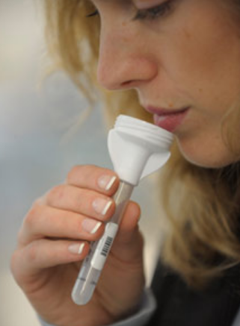

Slide 36
MAIL SPECIMENS
BACK

Slide 37
TEST RESULTS IN
6 – 8 WEEKS

Slide 38
INTERNET RESULTS

Slide 39
FAMILYTREEDNA

Slide 40
FAMILYTREEDNA
BEST FOR THE SEX CHROMOSOME TESTS

Slide 41
DEDICATED HOME PAGE
KIT NUMBER
PASSWORD

Slide 42
FAMILYTREEDNA
RESULTS

Slide 43
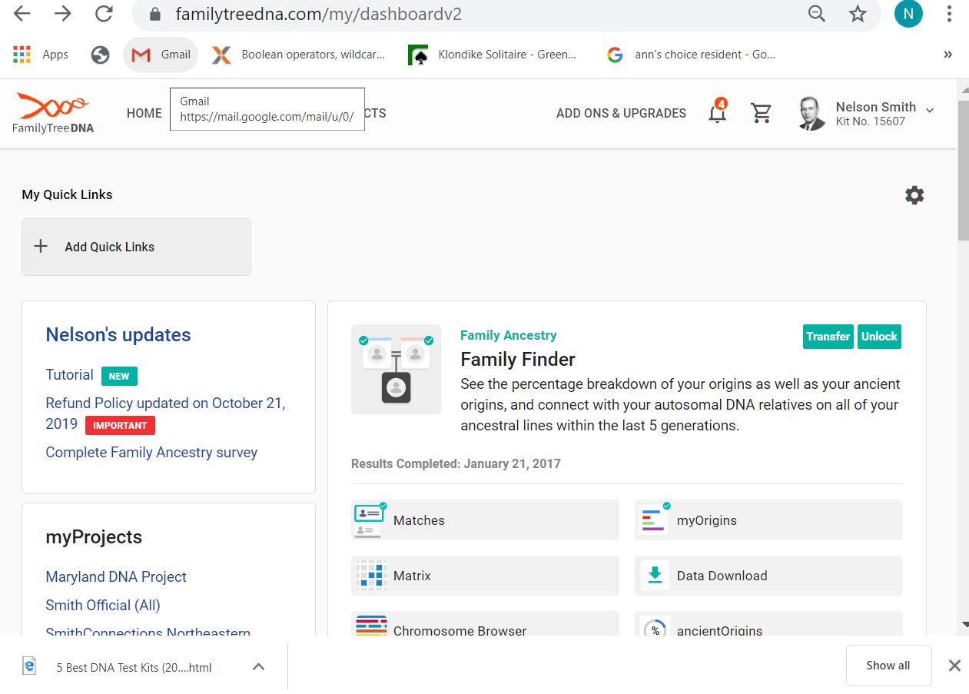
ANCESTRY - DNA

Slide 44
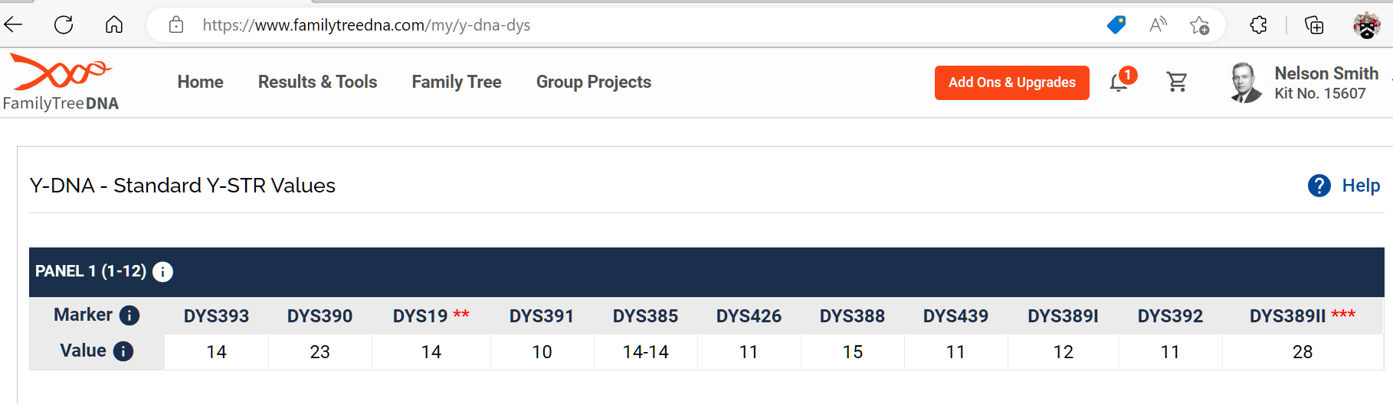

Slide 45
ANCESTRY - DNA

Slide 46
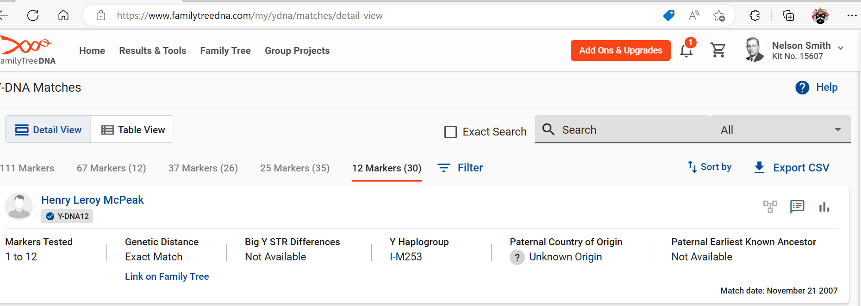

Slide 47
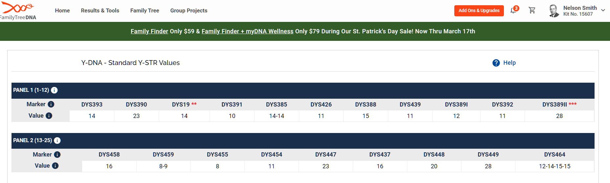

Slide 48
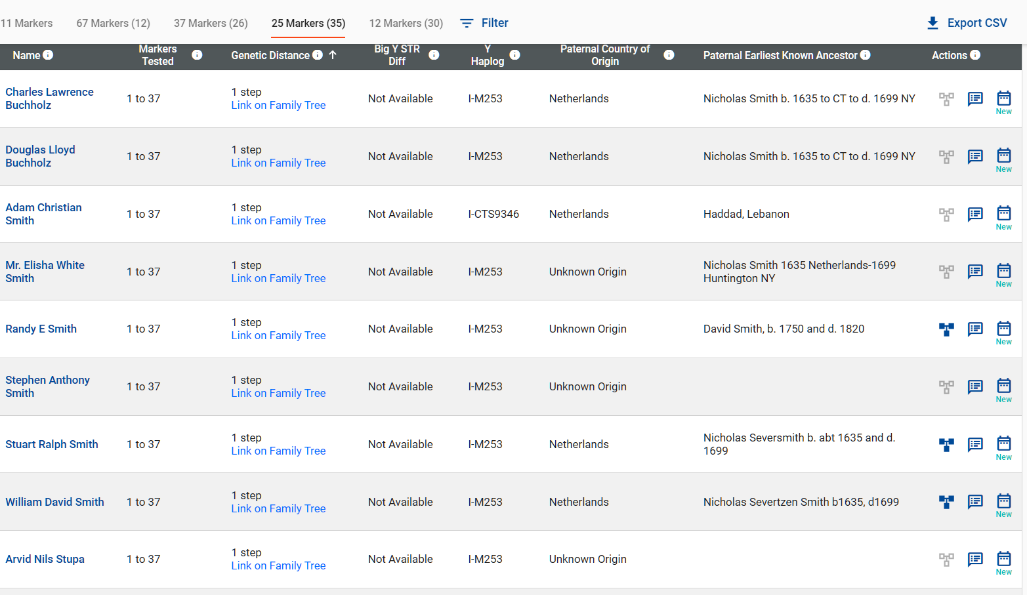

Slide 49
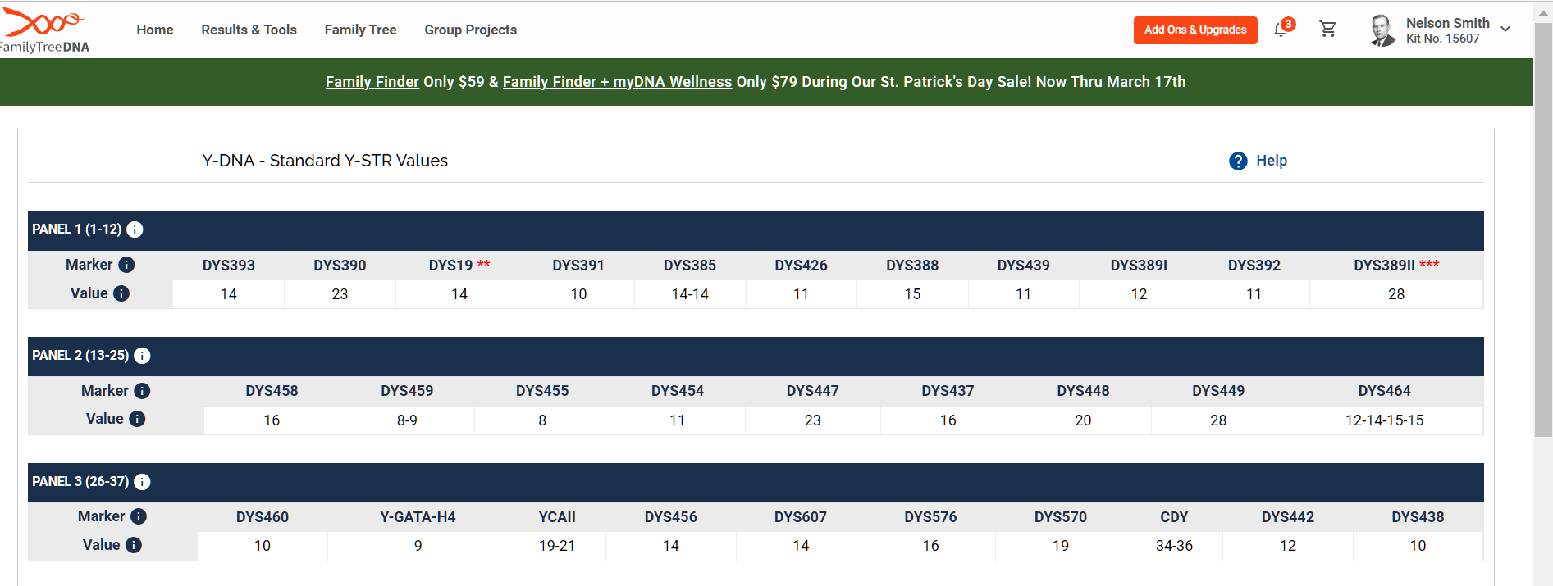

Slide 50
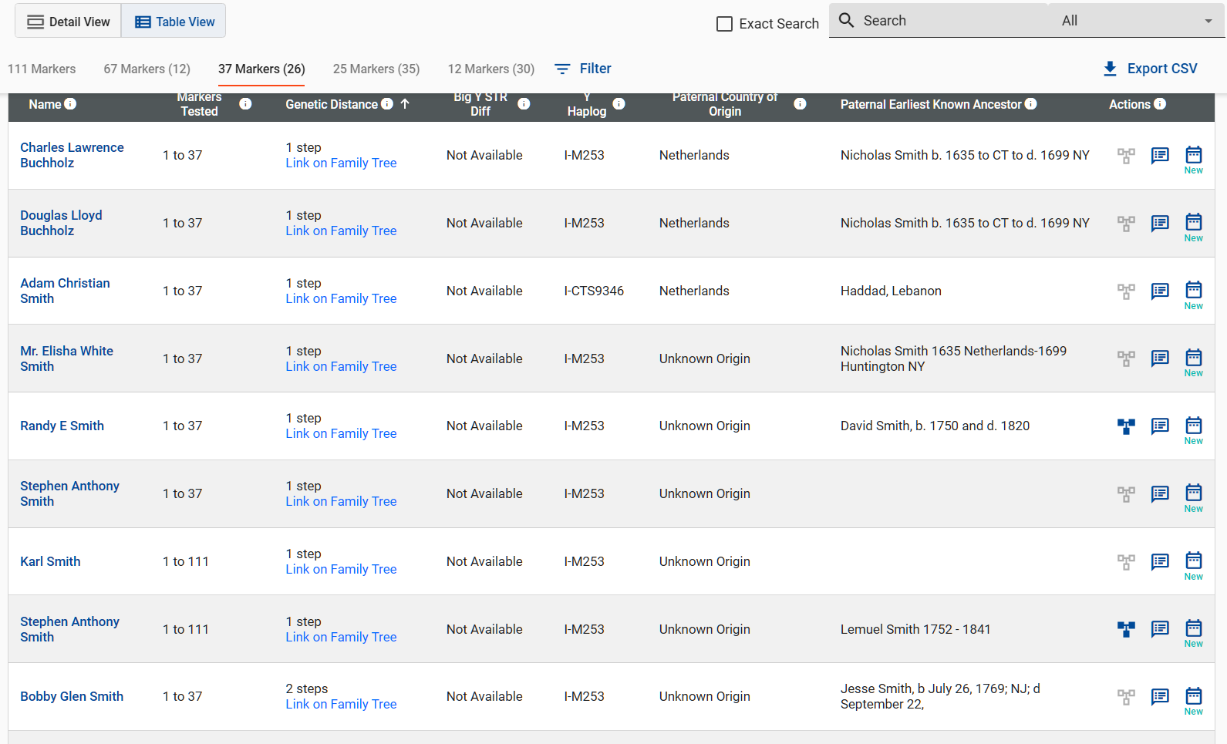

Slide 51
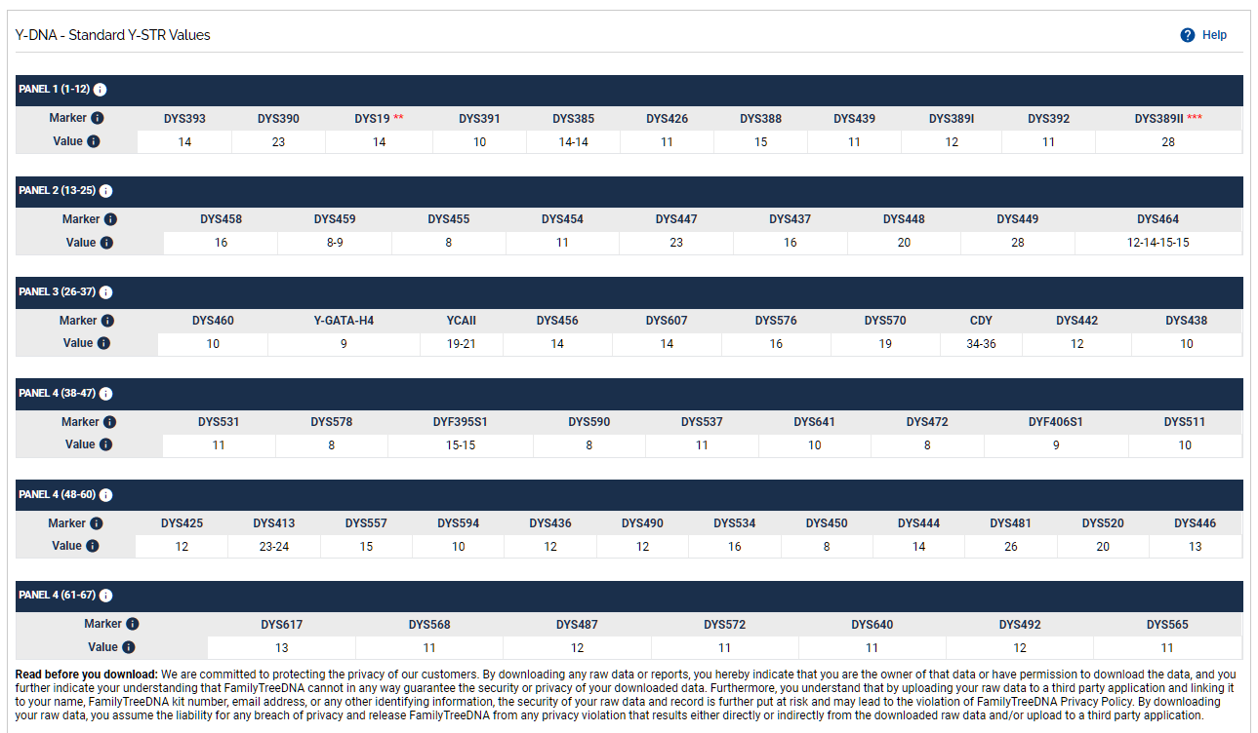

Slide 52
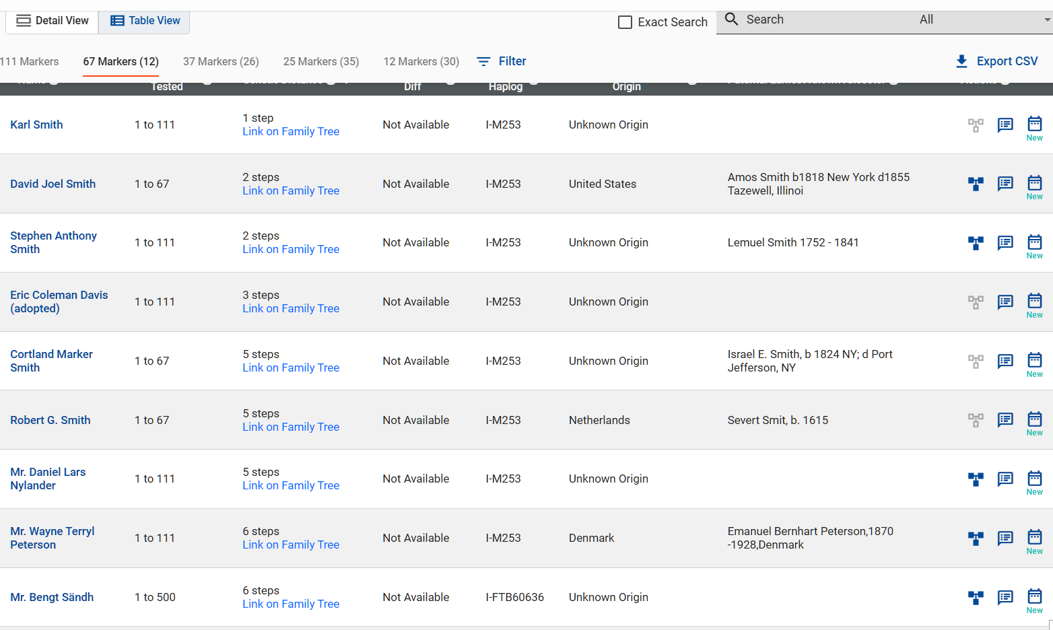

Slide 53

UNPACKING THE RESULTS

Slide 55
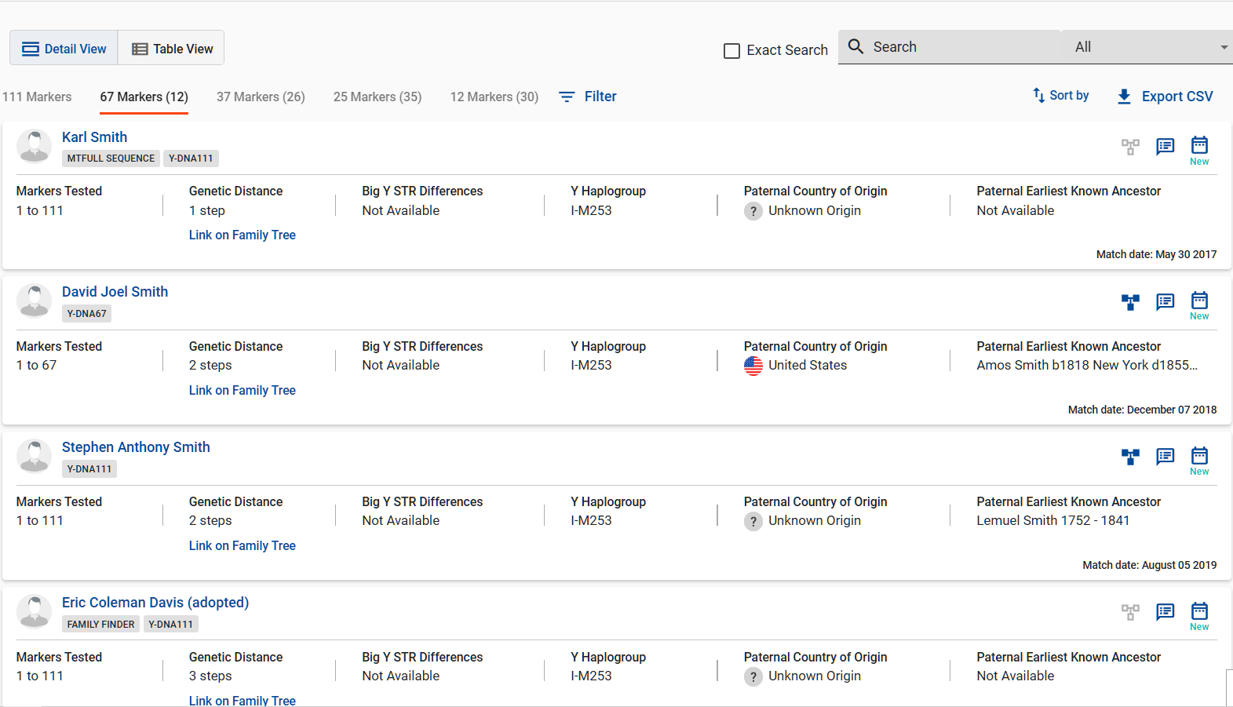

Slide 58
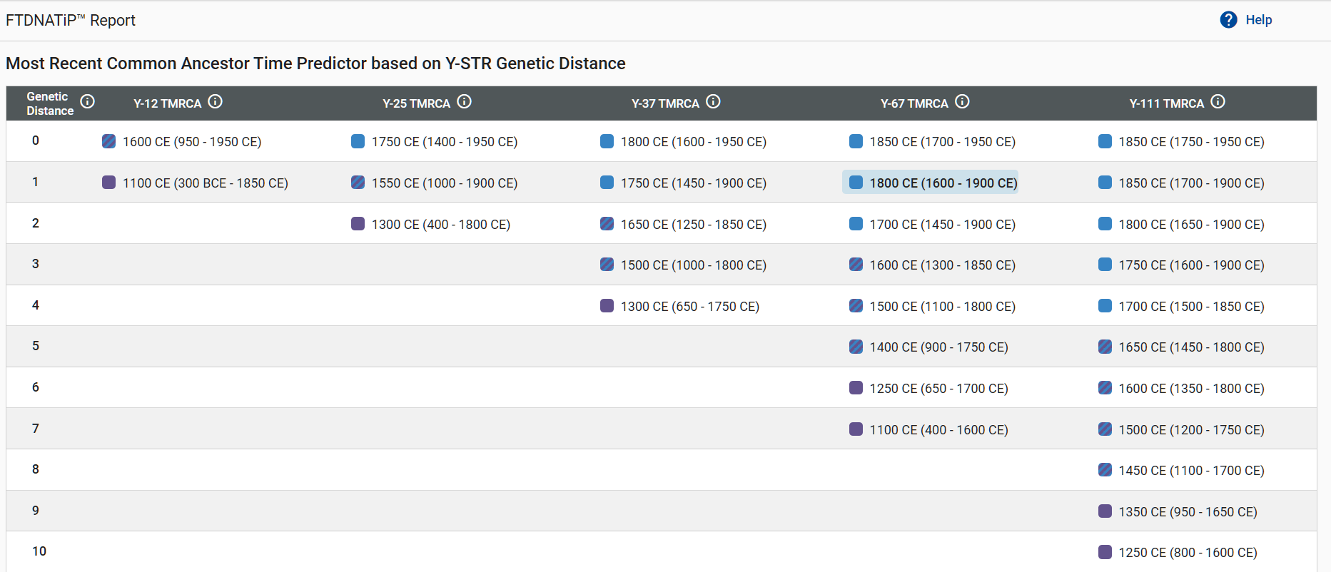

Slide 60
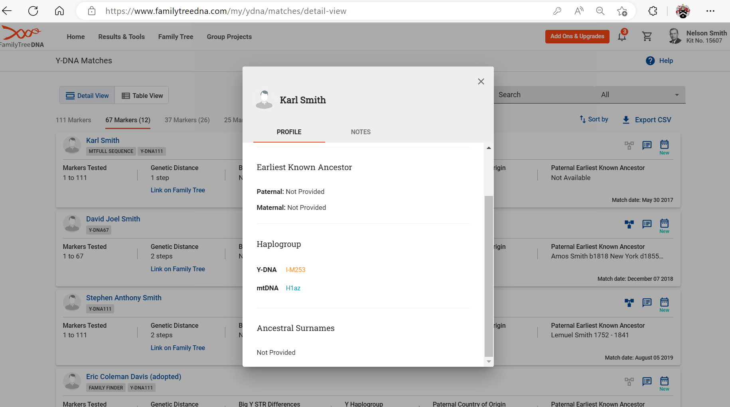
ANCESTRY - DNA

Slide 61
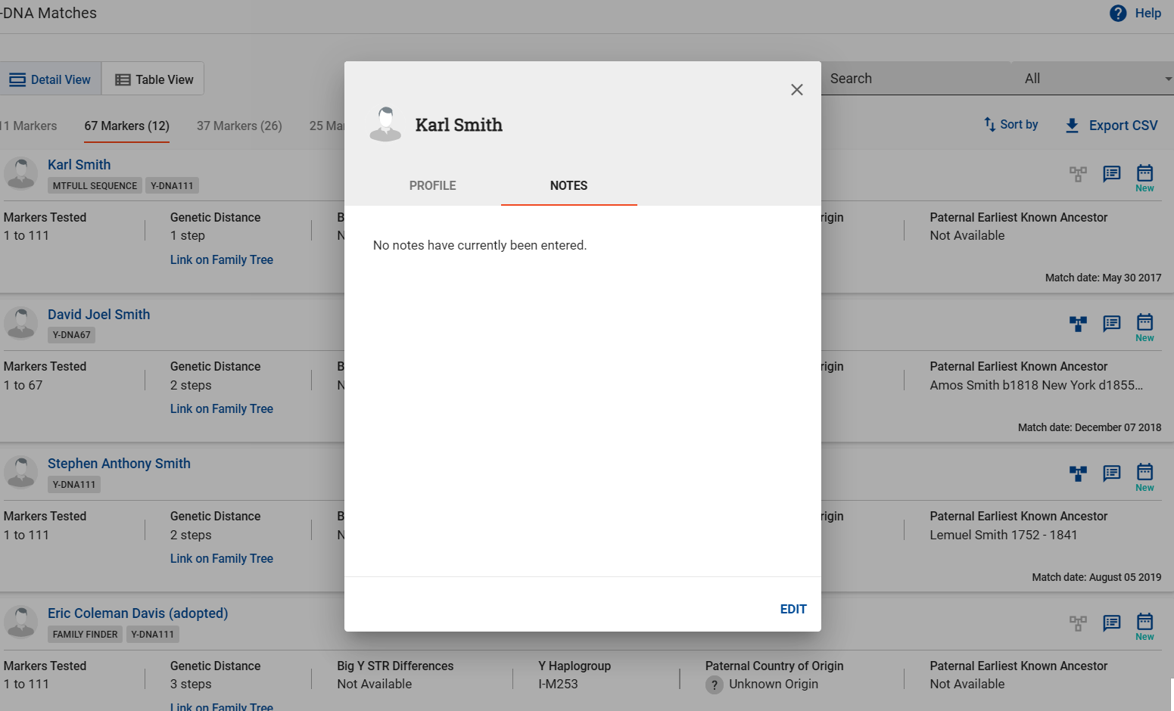
ANCESTRY - DNA

Slide 63
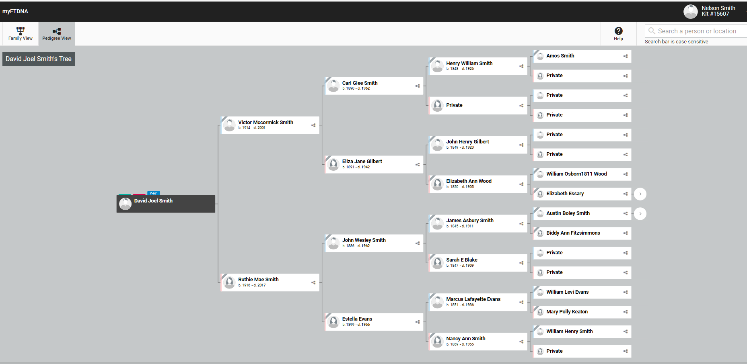
ANCESTRY - DNA

Slide 64
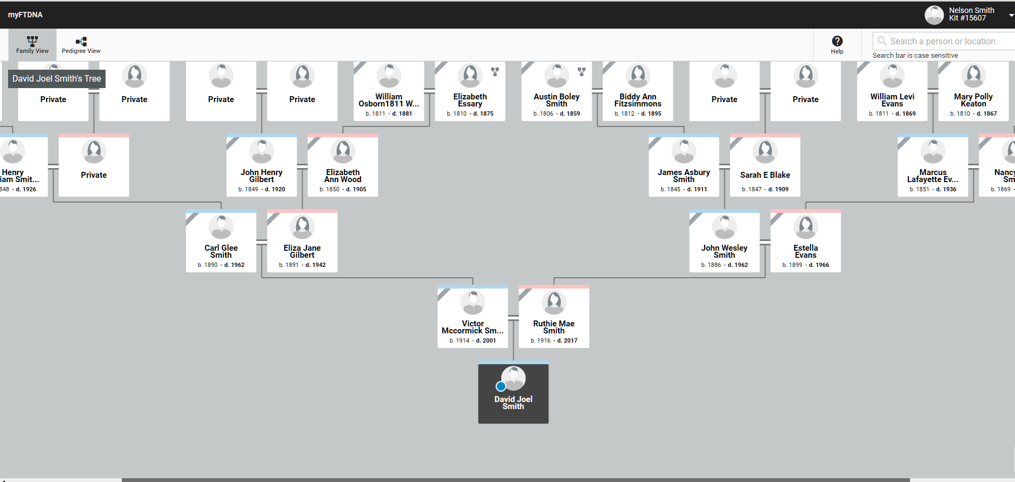
ANCESTRY - DNA

Slide 65
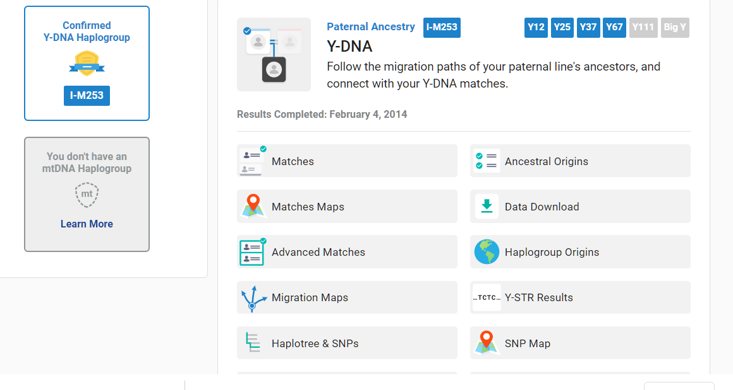
ANCESTRY - DNA

Slide 66
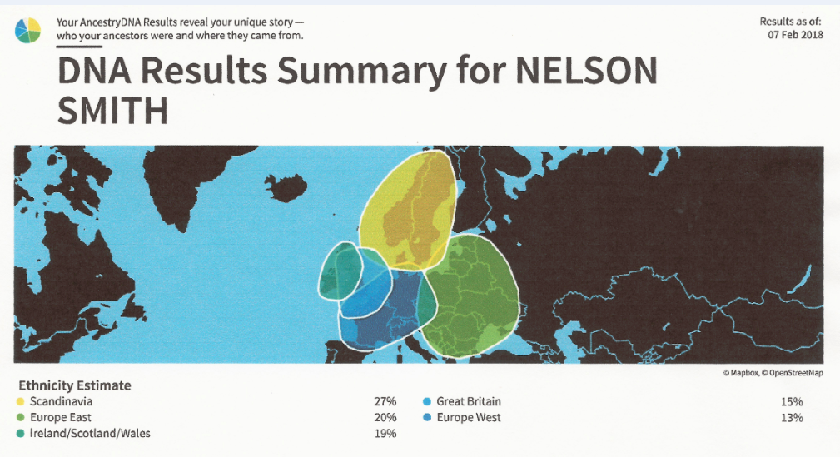
ANCESTRY - DNA

Slide 67
ANCESTRY - DNA

Slide 68
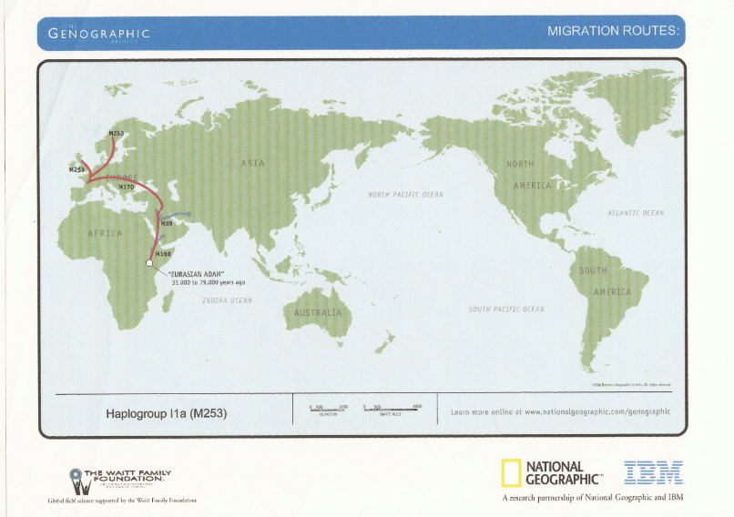
ANCESTRY - DNA

Slide 69
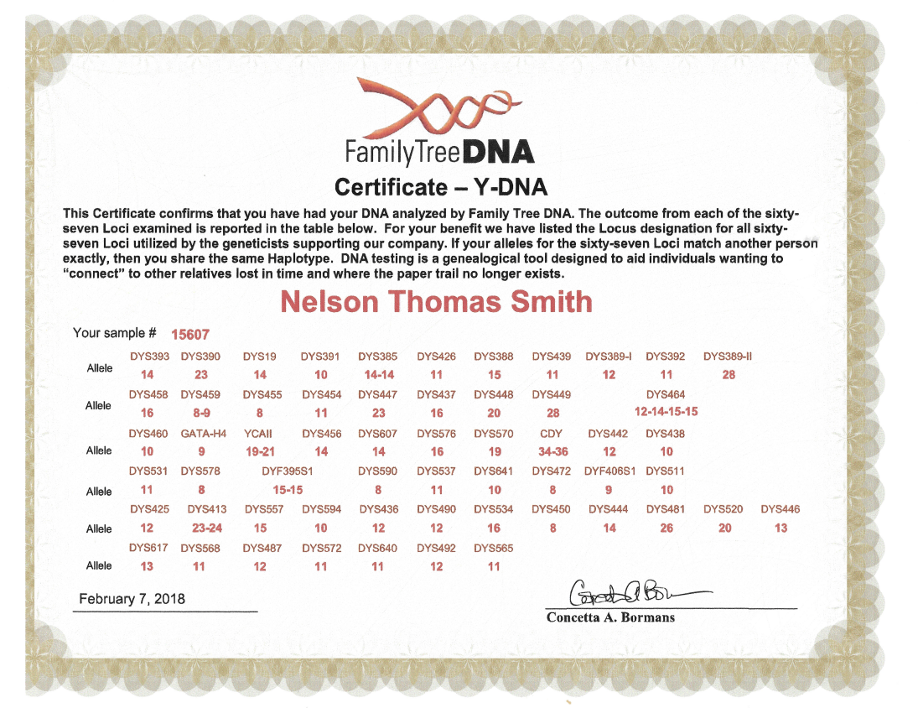

Slide 70
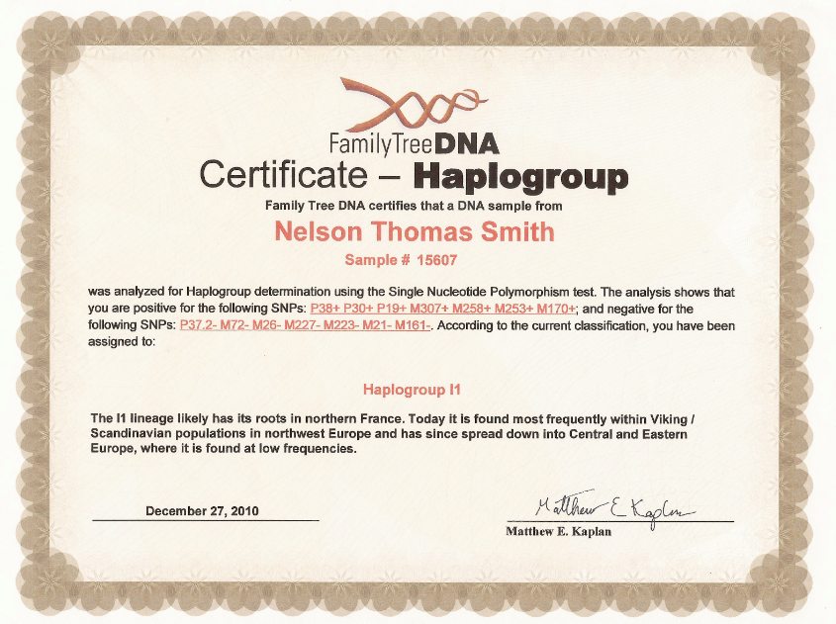
ANCESTRY - DNA

Slide 71
ANCESTRY - DNA

Slide 72
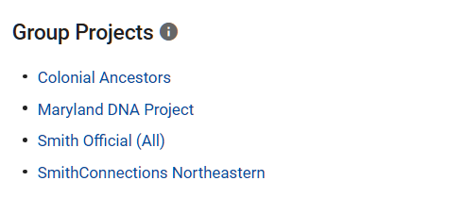
ANCESTRY - DNA

Slide 73
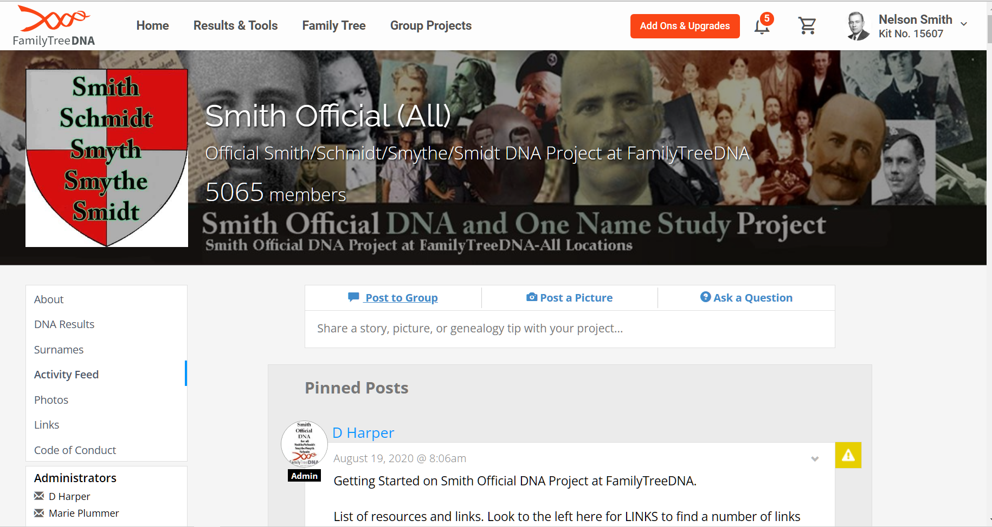
ANCESTRY - DNA

Slide 74
ANCESTRY - DNA

Slide 75
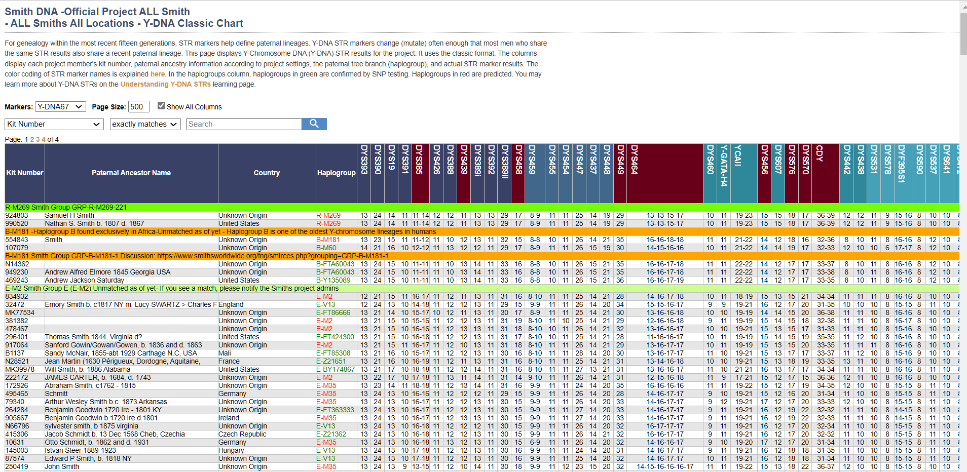

Slide 76
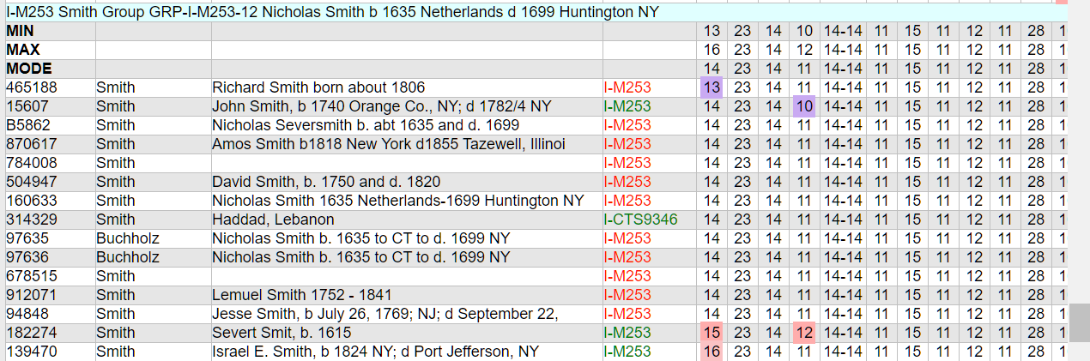
ANCESTRY - DNA

Slide 77
ANCESTRY DNA
RESULTS

Slide 78
ANCESTRY DNA
BEST FOR AUTOSOMAL TEST

Slide 79
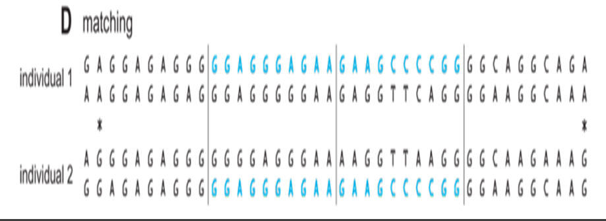
ANCESTRY - DNA

Slide 80
ANCESTRY - DNA
LIMITED ACCESS TO ANCESTRY.COM

Slide 81
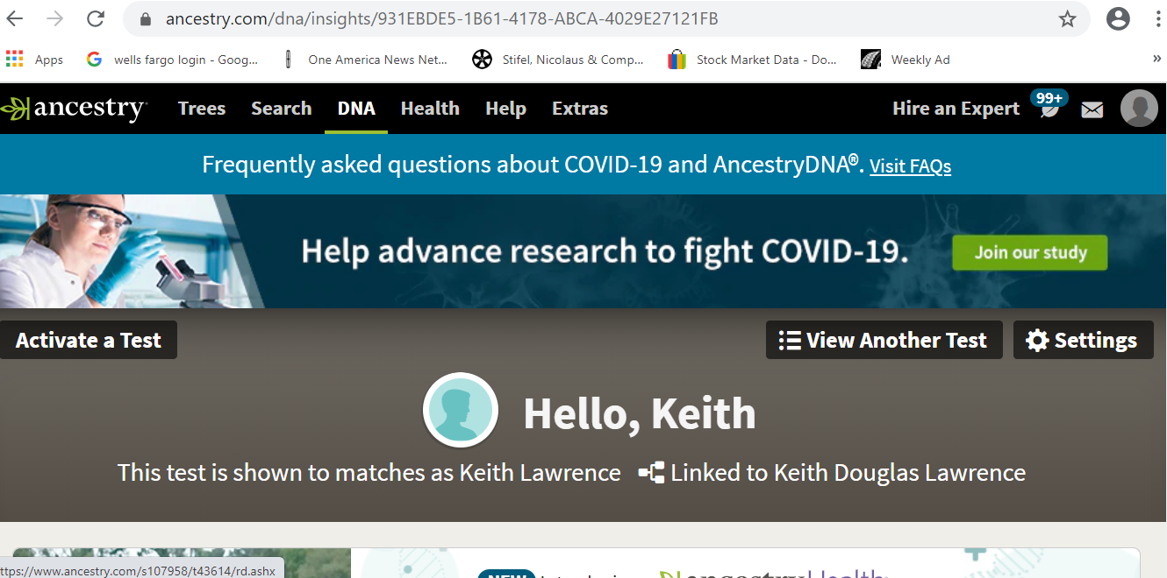
ANCESTRY - DNA

Slide 82
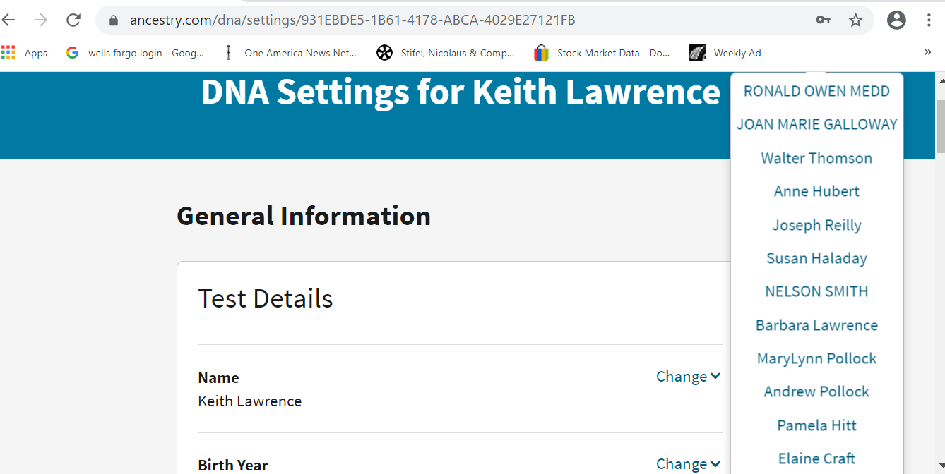
ANCESTRY - DNA

Slide 83
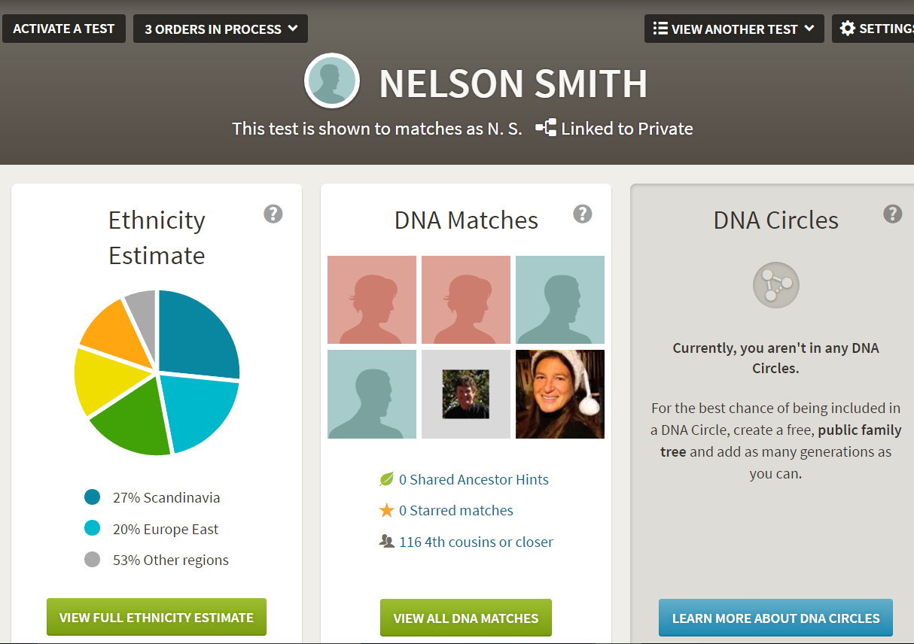
ANCESTRY - DNA

Slide 84
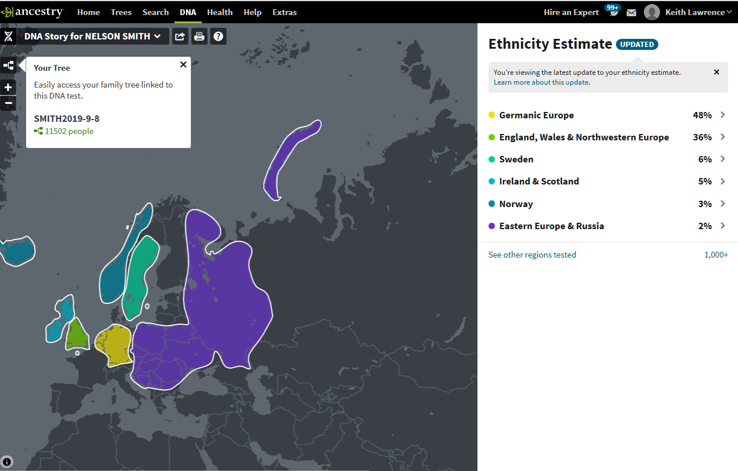
ANCESTRY - DNA

Slide 85
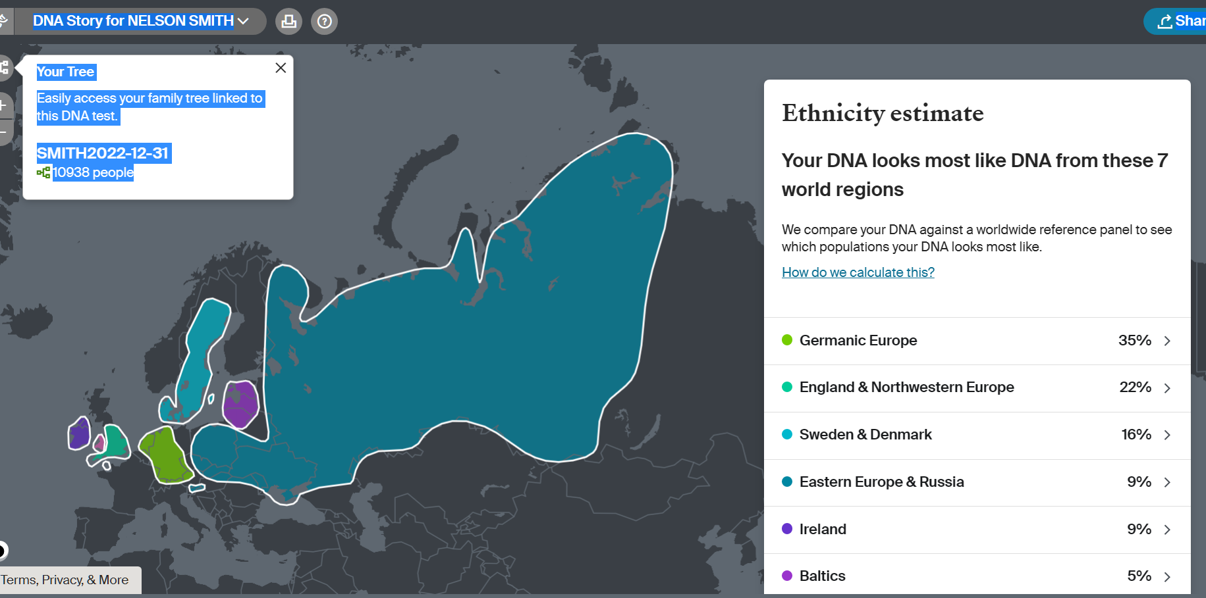
ANCESTRY - DNA

Slide 86
ANCESTRY - DNA

Slide 87
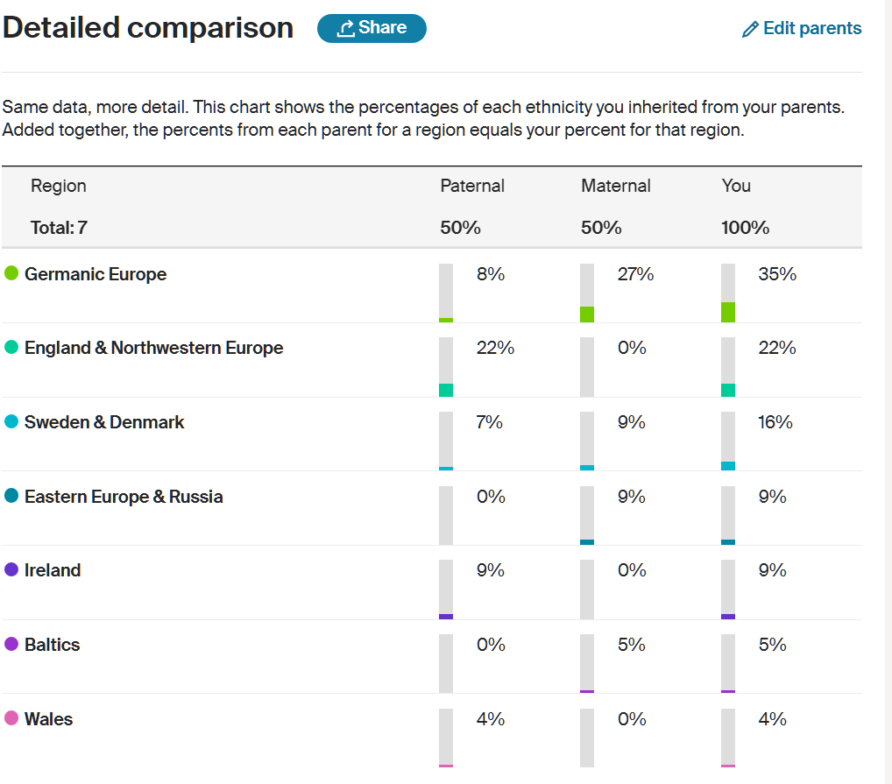
ANCESTRY - DNA

Slide 88
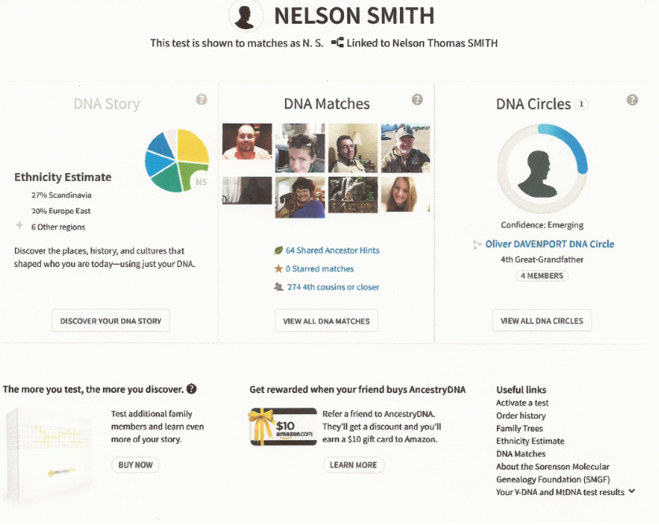
ANCESTRY - DNA

Slide 89
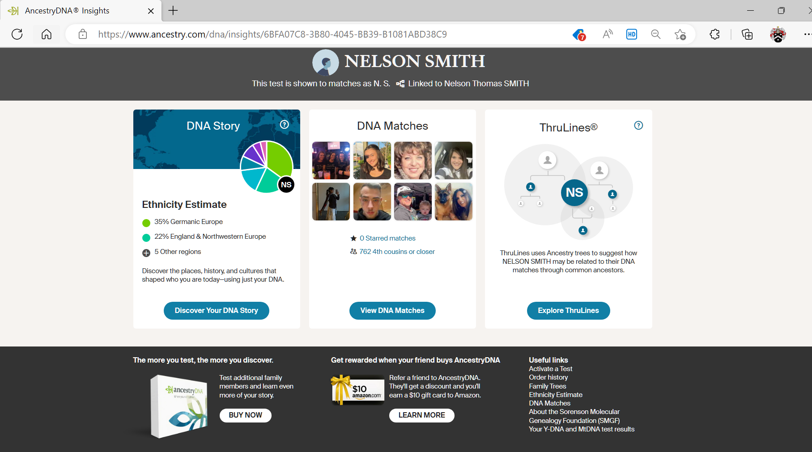
ANCESTRY - DNA

Slide 90
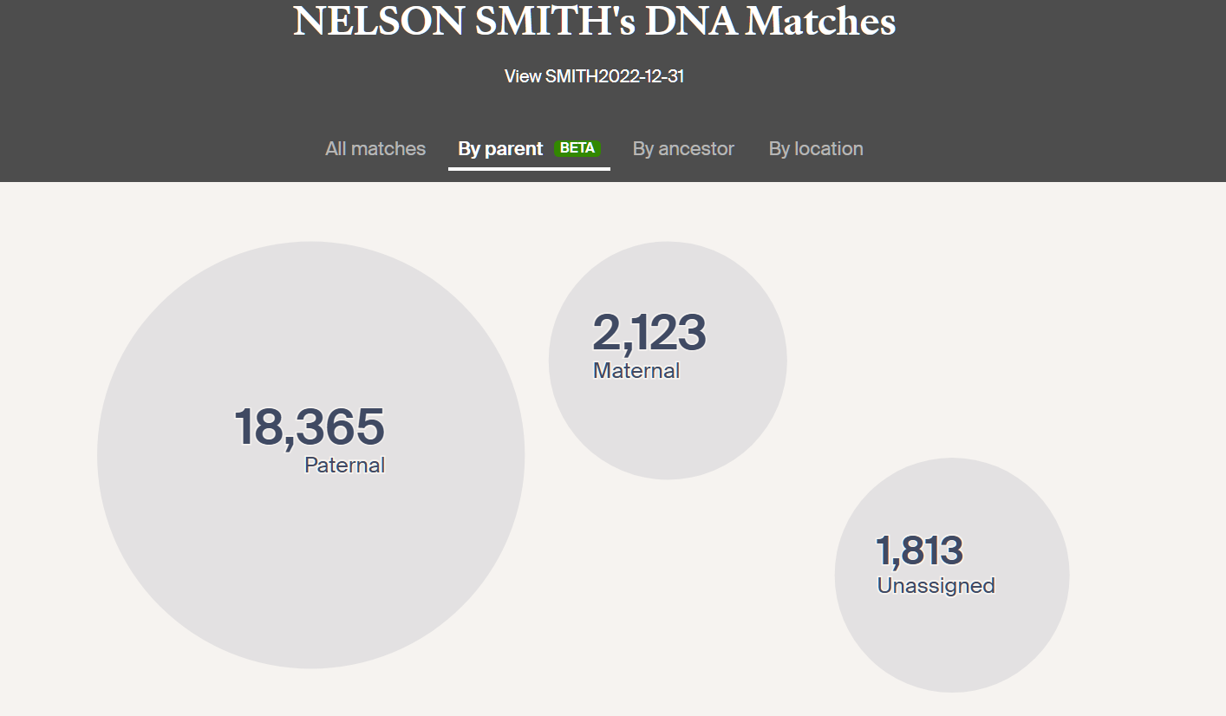

Slide 92
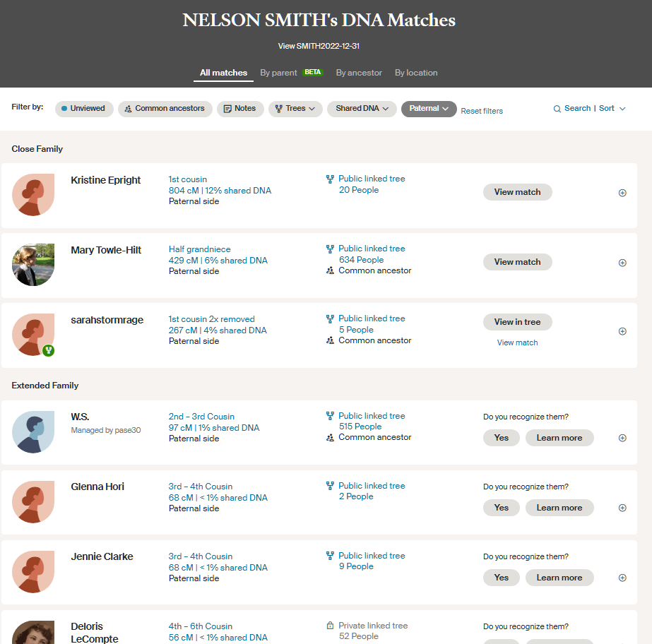

Slide 94
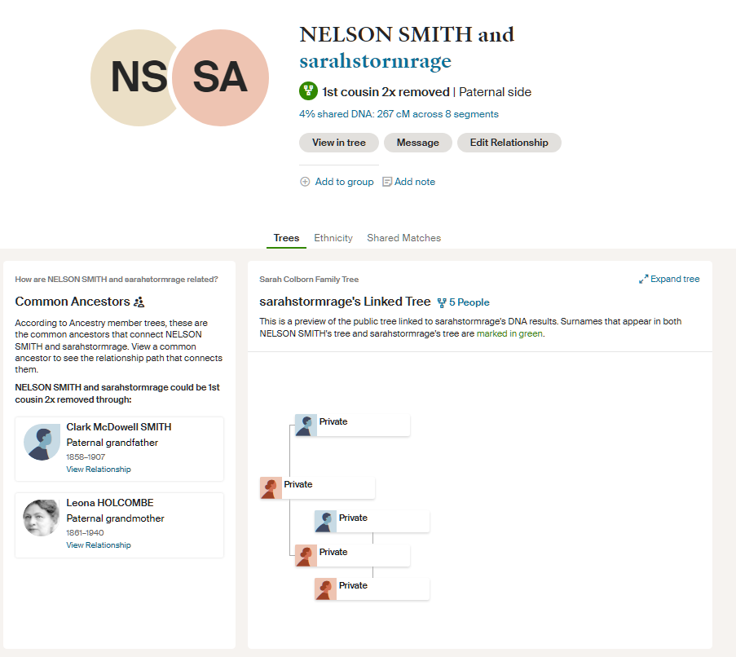

Slide 96
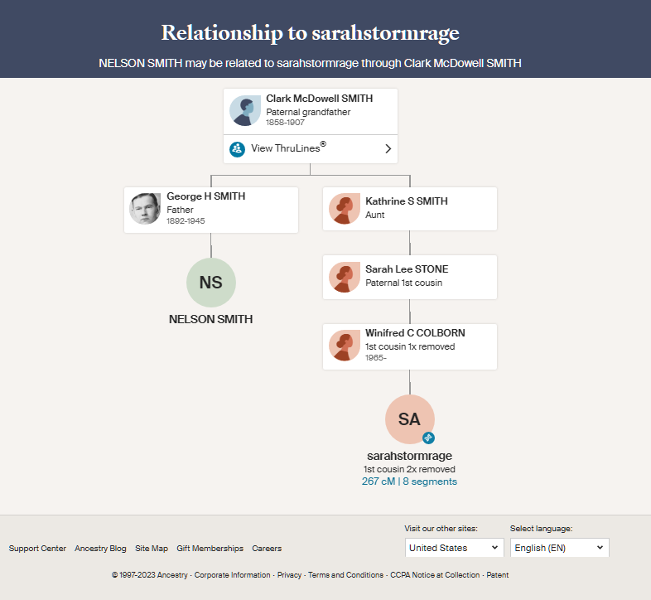

Slide 98
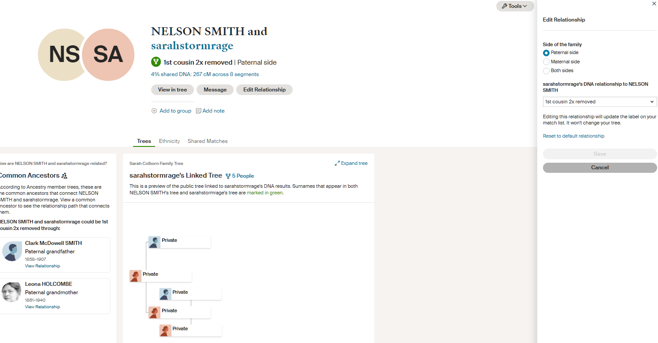

Slide 99
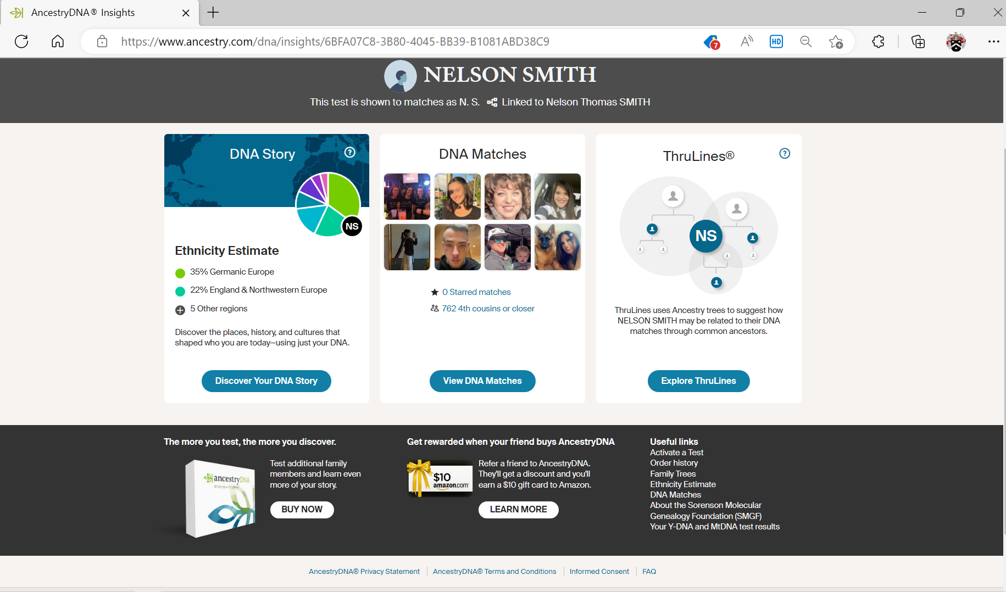

Slide 100
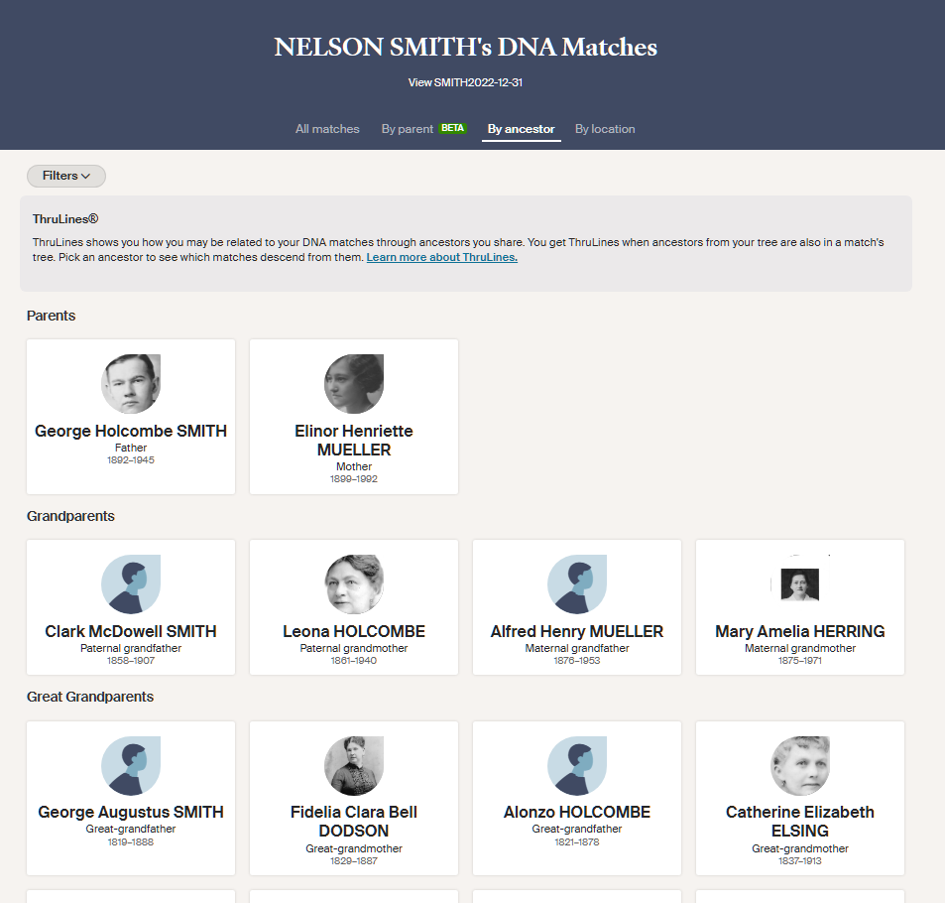

Slide 102
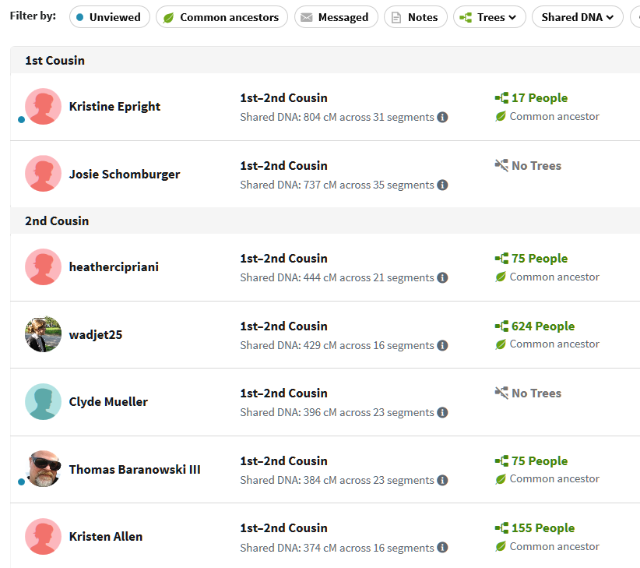
ANCESTRY - DNA

Slide 103

ANCESTRY - DNA

Slide 104


Slide 105

ANCESTRY - DNA

Slide 106
ANCESTRY - DNA
THIS IS WHY DNA
CAN ONLY
VERIFY

Slide 107
ANCESTRY - DNA
EACH TESTING COMPANY
HAS
+ & -

Slide 108
ANCESTRY - DNA
SUMMARY

Slide 109
ANCESTRY - DNA
ARE YOU
IDENTIFYING
OR
VERIFYING?

Slide 110
ANCESTRY - DNA
USE DNA TO VERIFY
USE SOMETHING ELSE TO IDENTIFY

Slide 111
ANCESTRY - DNA
DETERMINE YOUR OBJECTIVES BEFORE SELECTING A
TESTING COMPANY

Slide 112
ANCESTRY - DNA
CONSIDERATIONS
1. WHAT AM I TRYING TO DISCOVER?
2. WHAT WILL I DO WITH THE RESULTS?
3. HOW MUCH TIME DO I HAVE?
4. HOW MUCH MONEY AM I WILLING TO SPEND?

Slide 113
ANCESTRY - DNA
QUESTIONS???

