Slide 1
Backup & Recovery
WINDOWS
Applicable for purchasing a new computer
October 5, 2023
Questions any time.
Mixing in some factoids.

Slide 2
BACKUP WHAT?
You can only really backup your data – documents, emails, pictures, videos, music, spreadsheets, etc. Usually on your C drive.
The programs – Apps- that you use, such as Word, Zoom, etc. have to be reloaded on to your new machine. Find your passwords for these.
There are numerous ways/devices on how to backup. If you have a relatively small amount of data, say, under 50 gigabytes, you can use a flash drive, or two. That is the least expensive and easiest way to go. You can buy an external hard drive, around $50, for larger data banks. Or the Cloud. Or not at all.

Slide 3
WHY
Have you ever turned on your machine and nothing happened? You could lose everything.
P.S. This presentation and Gary’s previous one on the Cloud will be on our resident web site, on the AC3 Computer Club page.

Slide 4
EMAIL BACKUP
You generally have to back up your emails separately, if you even have to.
Each email handler, Outlook, Gmail, Aol, etc., are a little different but for all of them, you have to Export a file with your emails on it.
For Outlook, click on File, then click on Open & Export, then click on Import/Export and follow the instructions. You export your emails to a file, then, when needed, you import them.

Slide 5
REMEMBER……
Your computer has a hard drive and has memory. When your machine is off, memory is ‘cleared’. When you turn it on, your operating system is loaded into memory (Windows) and is executed and you then see your desktop. Your computer will first go to a peripheral drive, then to the hard drive.
Both your hard drive and memory contain both data (emails, documents, etc.) and programs (Apps) spread all over the place.
Your programs rarely change, but your data does, which is why you backup your data.

Slide 6
Making a SYSTEM RECOVERY DISC
Do it now.
Click on the Start menu.
Scroll down to Administrative tools
Click on Recovery
Follow the instructions
This will provide you a means of starting up your computer using this recovery drive. You can recover your system and determine the status of your data files. To recover if a catastrophic error and your machine cannot even boot up, put the system backup disc in your disc drive, and start your computer. It will go to that drive first to load your memory. Follow the instructions.

Slide 7
Backup Options
There are numerous software packages that basically backup your data constantly, so you always have a reserve duplicate of your data.
The one I use is called iDrive. It costs $20 for the first year and $100 per year thereafter and provides 5 terrabytes of storage. Usually more than enough. The first 10G are free. iDrive constantly backs up your data.
Lots of others our there. Your data is accessible from other hardware if needed. Key in ‘Data Backup Services’ in our Duckduckgo browser.
You can always use the Cloud. Gary had a recent presentation on that and you can view it on our resident web site.

Slide 8
WHAT DOES CLOUD STORAGE COST?
OneDrive – 5 GB free
  $1.99/mo for 50 GB
Dropbox – 2 GB free
  $9.92/mo for 1 TB
Google Drive – 15 GB free
  $1.99/mo for 100 GB
  In simplest terms, cloud computing means storing and accessing data and programs over the internet instead of your computer's hard drive. The cloud is just a metaphor for the internet. The cloud is simply a bunch of computers somewhere other than your home.

Slide 9
Review
You will have a new system backup drive.
You will have backed up all your data.
You will have all your passwords for your special applications.
You can now possibly recover from a hard drive error or you can begin the purchase and install of a new computer.

Slide 10
BACKUP
YOUR DATA, NOT SYSTEM DATA. This is to back up and recover your data files only. It does not include your system or programs.
BACKUP TO AN EXTERNAL HARD DRIVE
Plug in and open the EXTERNAL hard drive (go to computer on Start and click on the drive)
Create a new folder – call it something to identify when the backup occurred.
Click on C drive
Click on Users
Click on your name (Example-Bob)
Highlight all the items under your name (use shift key)
Drag the entire file structure to the new folder created on the external hard drive
All items will be copied, and you will have the backup.

Slide 11
RECOVERY - Careful
RECOVERY
Delete data on your regular C hard drive under your name (example-Bob). Be careful. You will be deleting all of your personal data. Leave an empty folder with your name (example-Bob). If you want to, create an empty folder (call it Hold-C) on your C drive and copy your current data to that folder. This way, if something happens to the restore process, you still have your corrupt data,
Plug in and open the External hard drive.
Open the folder of your name.
Highlight your data.
Drag it to the empty folder on C.
Your data is restored from the backup file.

Slide 12
Size and so forth
BYTE – One character (a letter, a number, etc.)
1,000 bytes = one Kilobyte
1,000,000 = one Megabyte
1,000,000,000 = one gigabyte
1,000,000,000,000 = one terabyte
All characters (bytes) in a computer are made up of on/off bits.
Every byte contains eight bits. The combination of these bits make up every letter, number, and symbol.

Slide 13
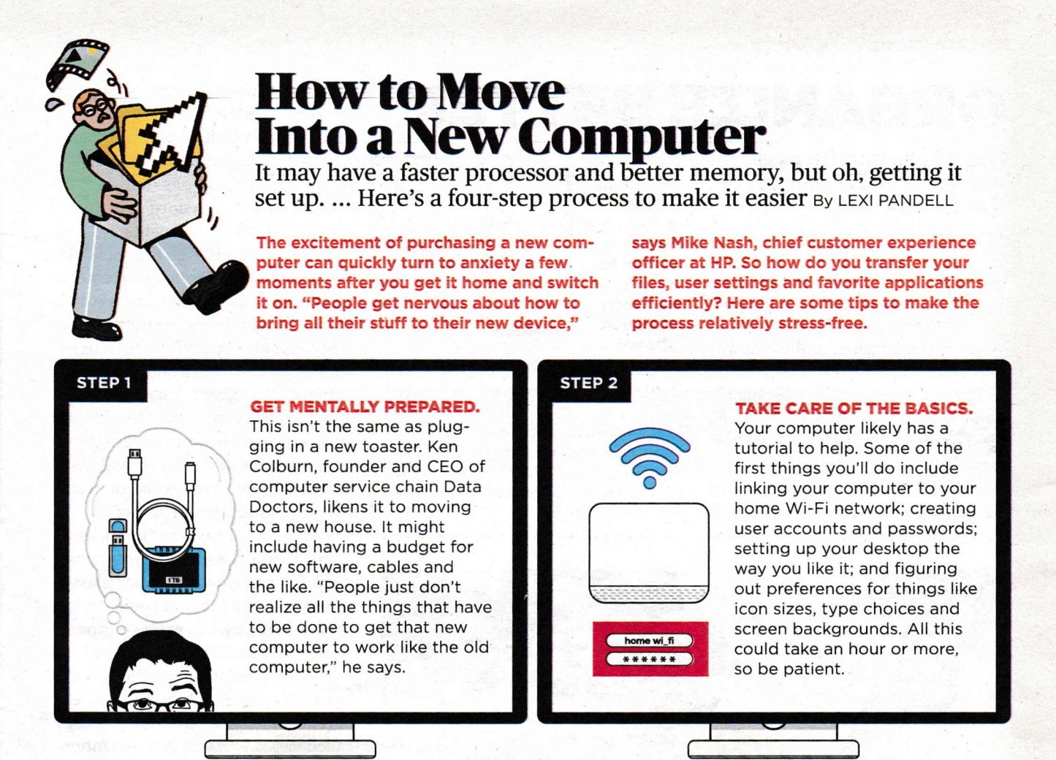
AARP Magazine - top

Slide 14
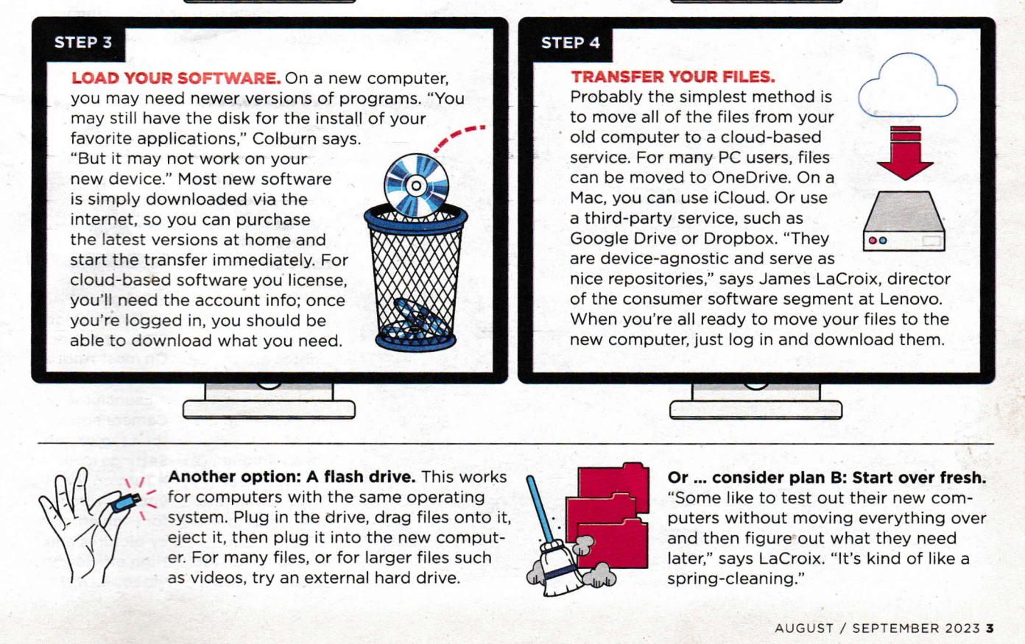
AARP Magazine - bottom

Slide 15
Here is what I did when I needed a new machine.
1. Review and determine all external software needed to carry over. Find out passwords. Ex. Zoom, Skype, tax software, etc.
2. Backup the C drive. Either use a external hard drive or purchase a flash drive to handle your size. Export your emails – each email handler is different.
3. Restore to the new machine only what you need for now. This gives you a fresh start.
4. When you need an additional file, use the backup you just created and copy it to your new machine.
5. This gives you a cleaner and faster new system.

Slide 16
What do I do now?
I have basically three sets of my data. My hard drive, my external disc drive, and my data on iDrive.
WHY?
Paranoia? Because of my involvement in many activities here at AC, especially our resident web site, I feel I have to keep a lot of stuff, just in case.

Slide 17
TRY TO DO………..Keep on Rolling
Turn your machine off once a week. Make sure you use the Windows button on the lower left and click on Power and Shutdown. This helps keep memory clear and will improve your speed. When you power up, it clears all the old stuff our of memory.
Do it also for your Apple phone and iPad. On these devices, you should also ‘scrape’ up old programs often (daily) to keep up your speed.
If data access seems slow, you may want to defrag your hard drive. Go to Windows button, click on Windows Administrative Tools, and run clean up and defrag.

Slide 18
QUESTIONS?

